Slide 1
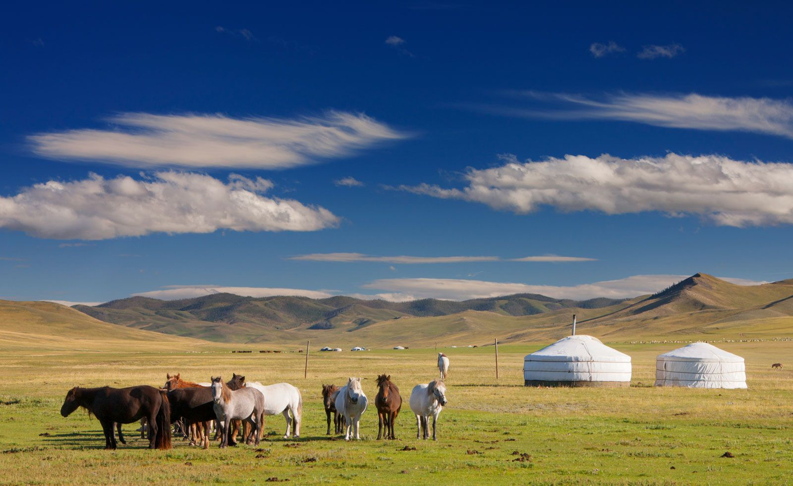
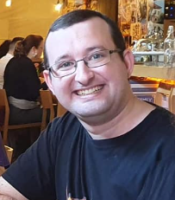
Meet Mr McCredie
All about your teacher!

Slide 2
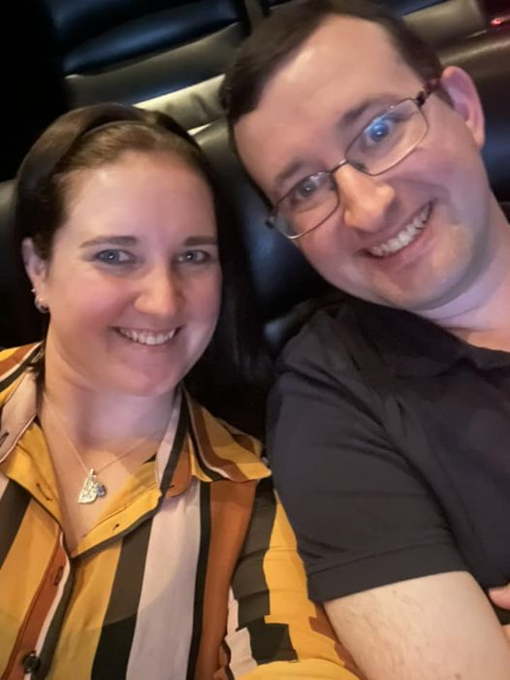
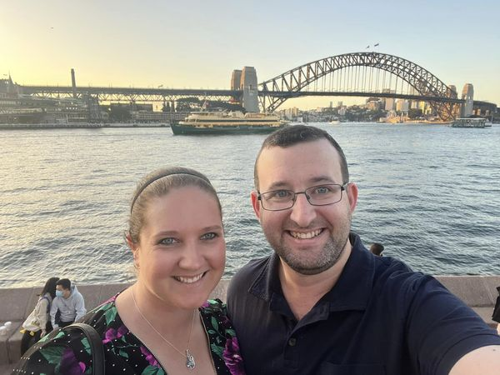
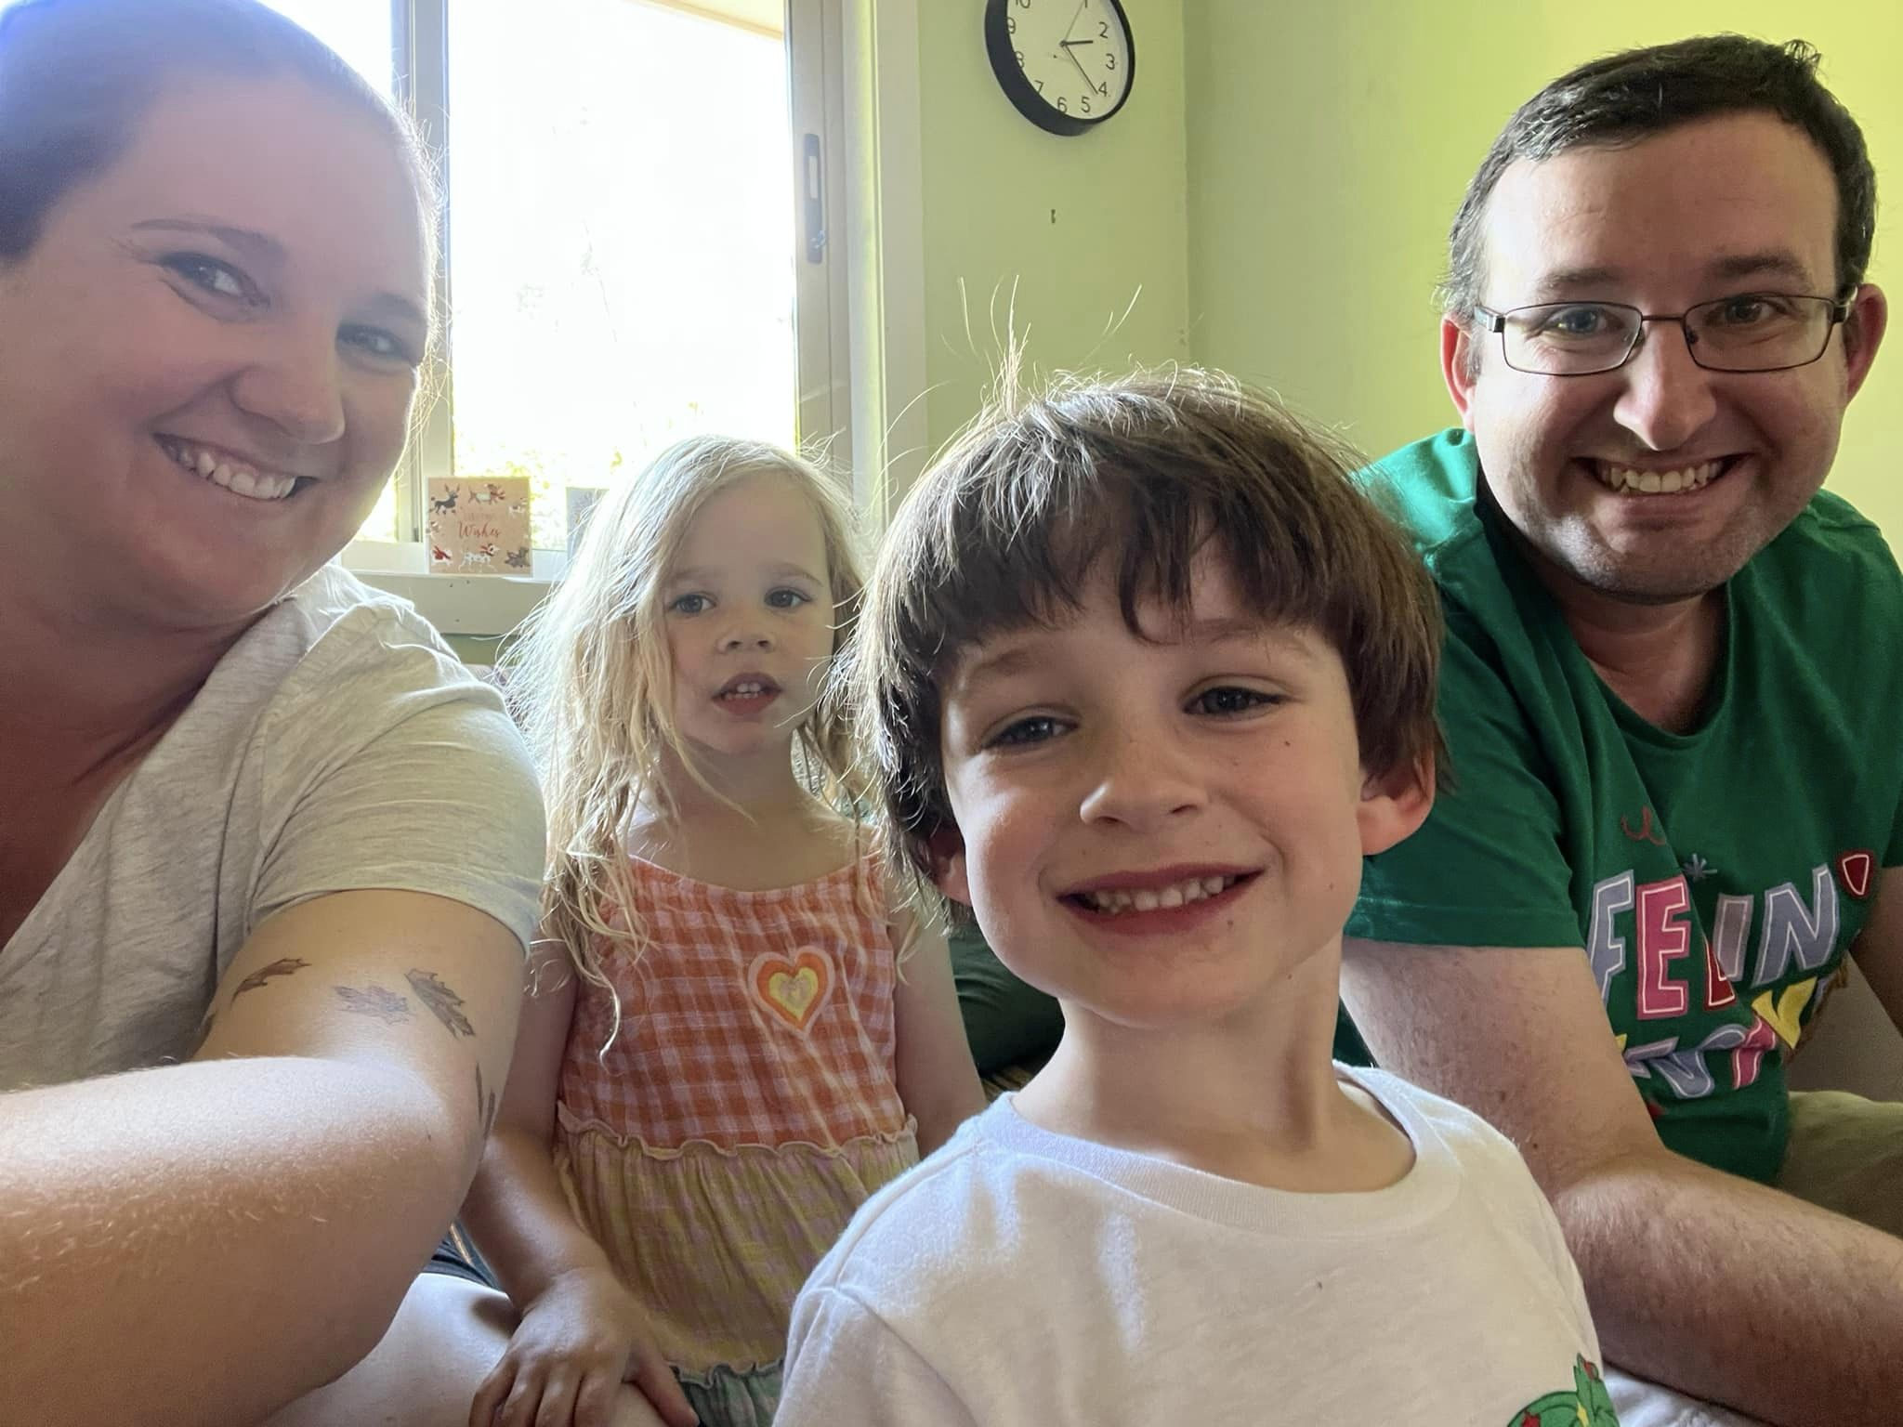
MY FAMILY
I am married to my wife Ash. She’s a teacher as well, but at a High School. We live in the Blue Mountains. I have one sister, who is married with two kids. I love spending time with my niece and nephew.

Slide 3
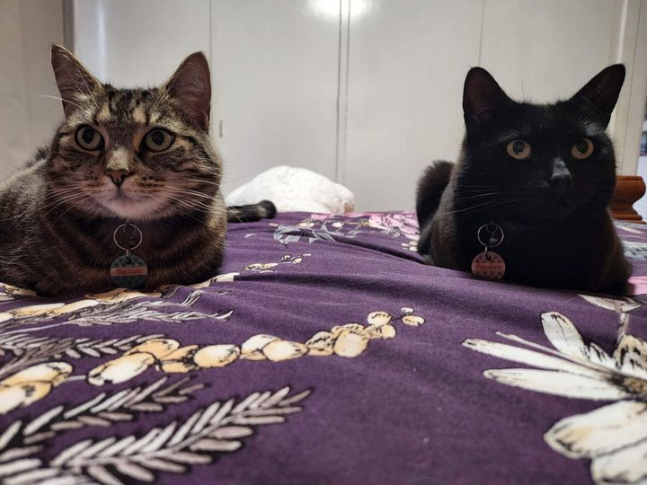
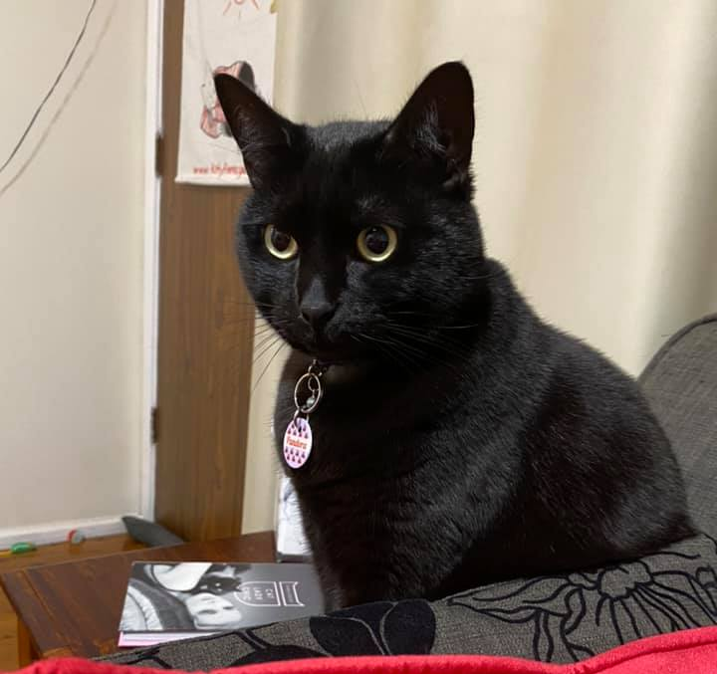
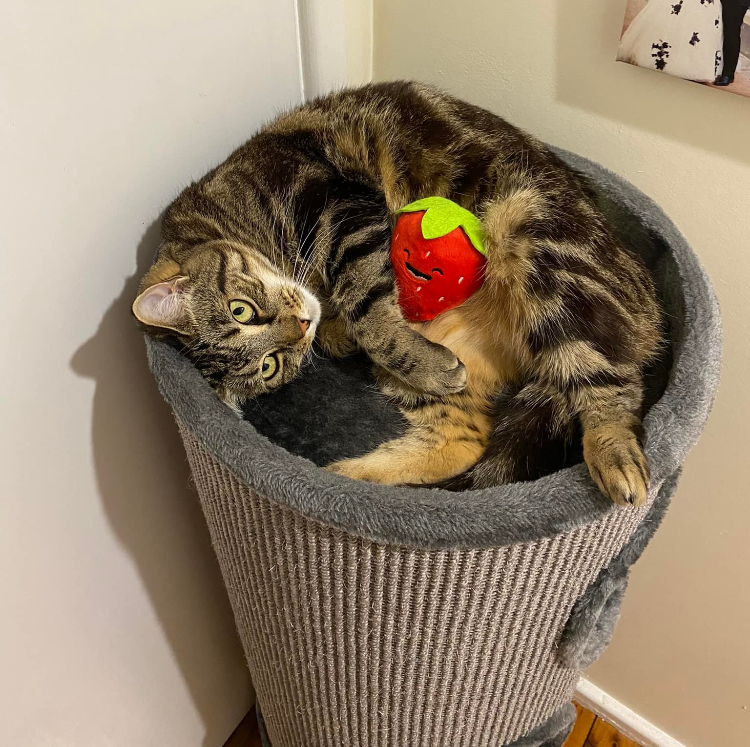
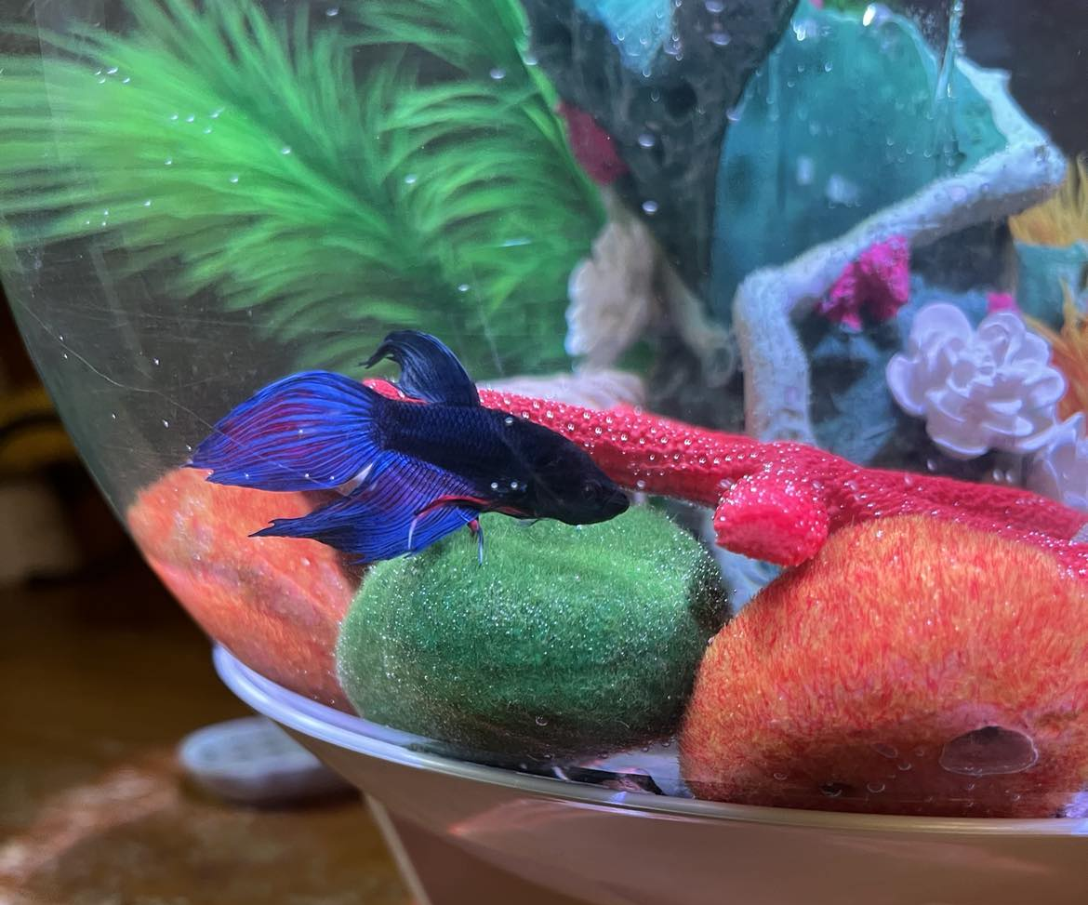
MY PETS
I have two female rescue cats – one black named Pandora and one tabby named Saphira. They usually get called Pan and Saph (except when they’re in trouble!)
I also have one blue Siamese Fighting Fish called Cobalt.

Slide 4
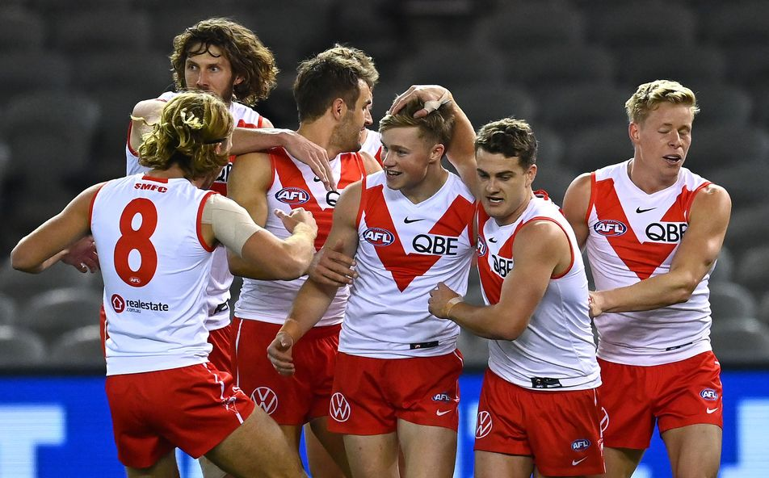
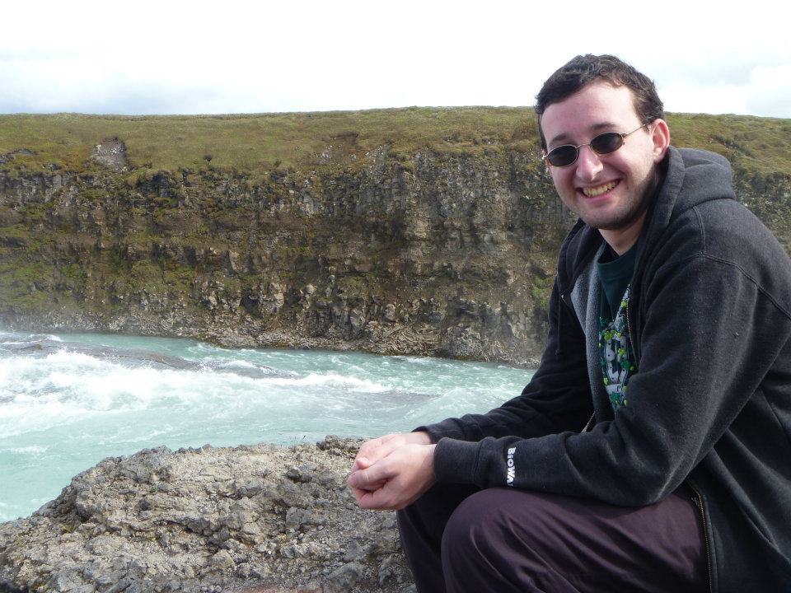
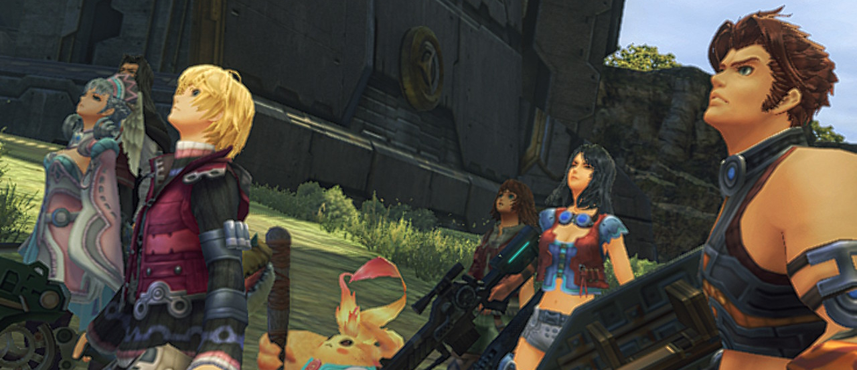
HOBBIES & INTERESTS
I have a lot of interests outside of school. I love to travel, but also love staying home and reading, watching movies or playing video games. I am part of a Dungeons and Dragons group with some friends. I love sports, especially AFL and cricket, but I will watch just about anything.

Slide 5
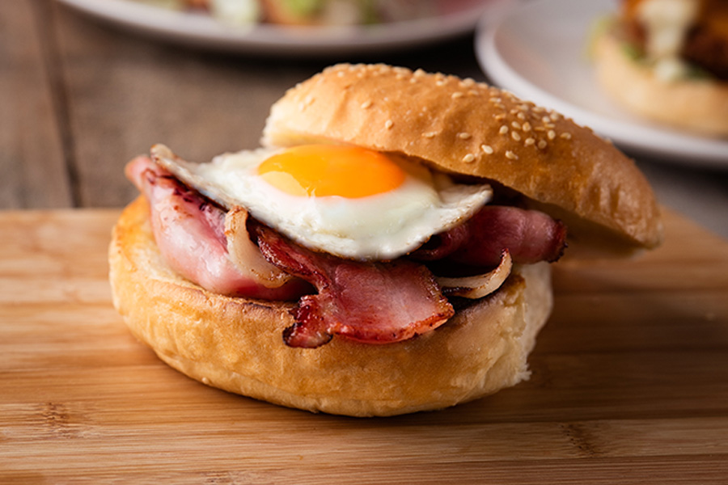
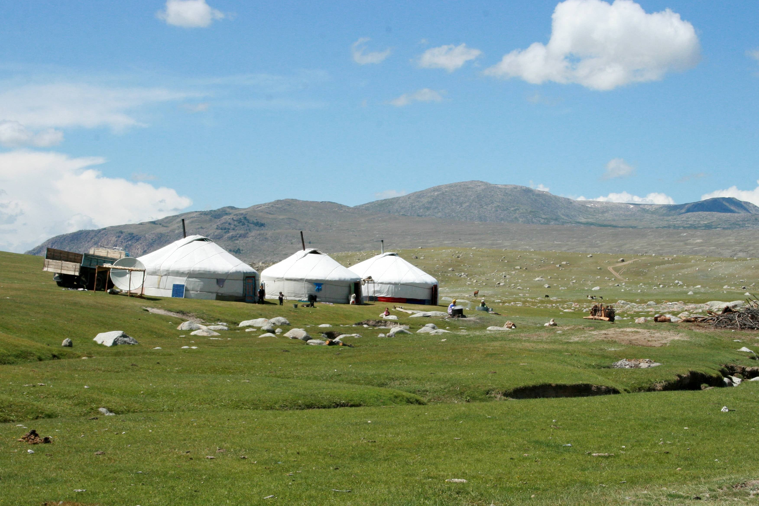
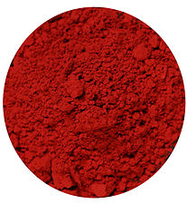
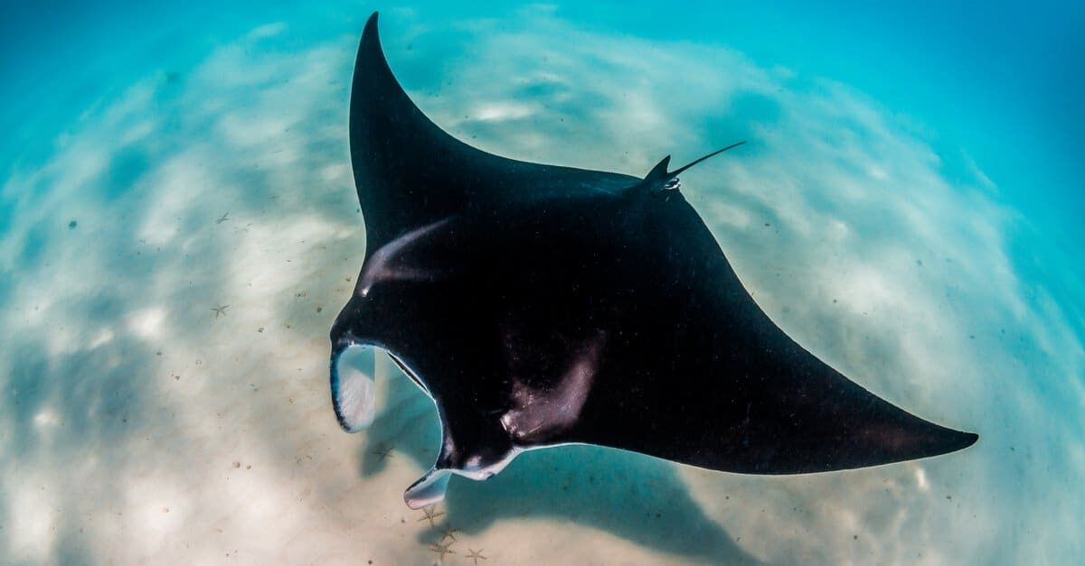
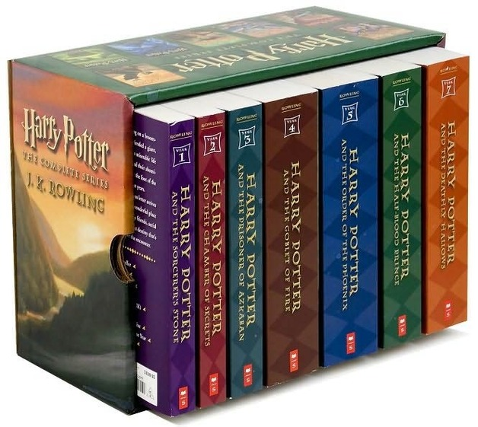
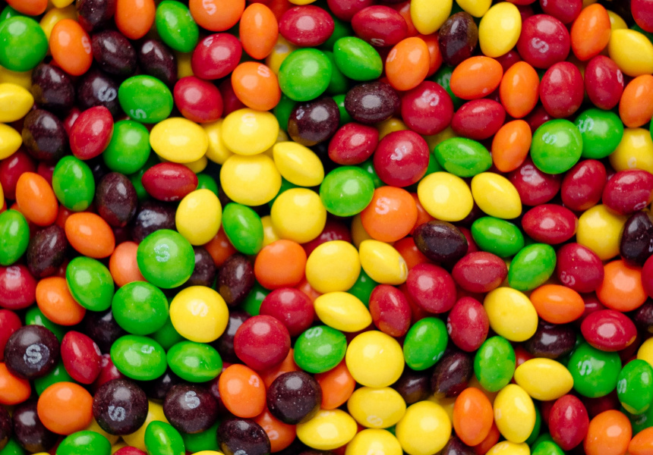
MY FAVOURITES
Food
Bacon and Egg Roll
Red
Stingrays
Skittles
Holiday
Mongolia
Star Wars
(all of them)
Harry Potter
(all of them)
Mass Effect 2
Colour
Movie
Animal
Book
Candy
Game

Slide 6
Fun Facts about me
I have been to every state in Australia except Tasmania and over 20 countries
I know the alphabet in sign language
I can juggle, just not for very long
I have never broken a bone
I played AFL, cricket and basketball when I was younger
When I was travelling in Iceland, I got to go inside an extinct volcano and snorkel where the country is splitting apart

Slide 7
2024
I cannot wait for the year to start and see what new adventures it brings.

