Slide 1
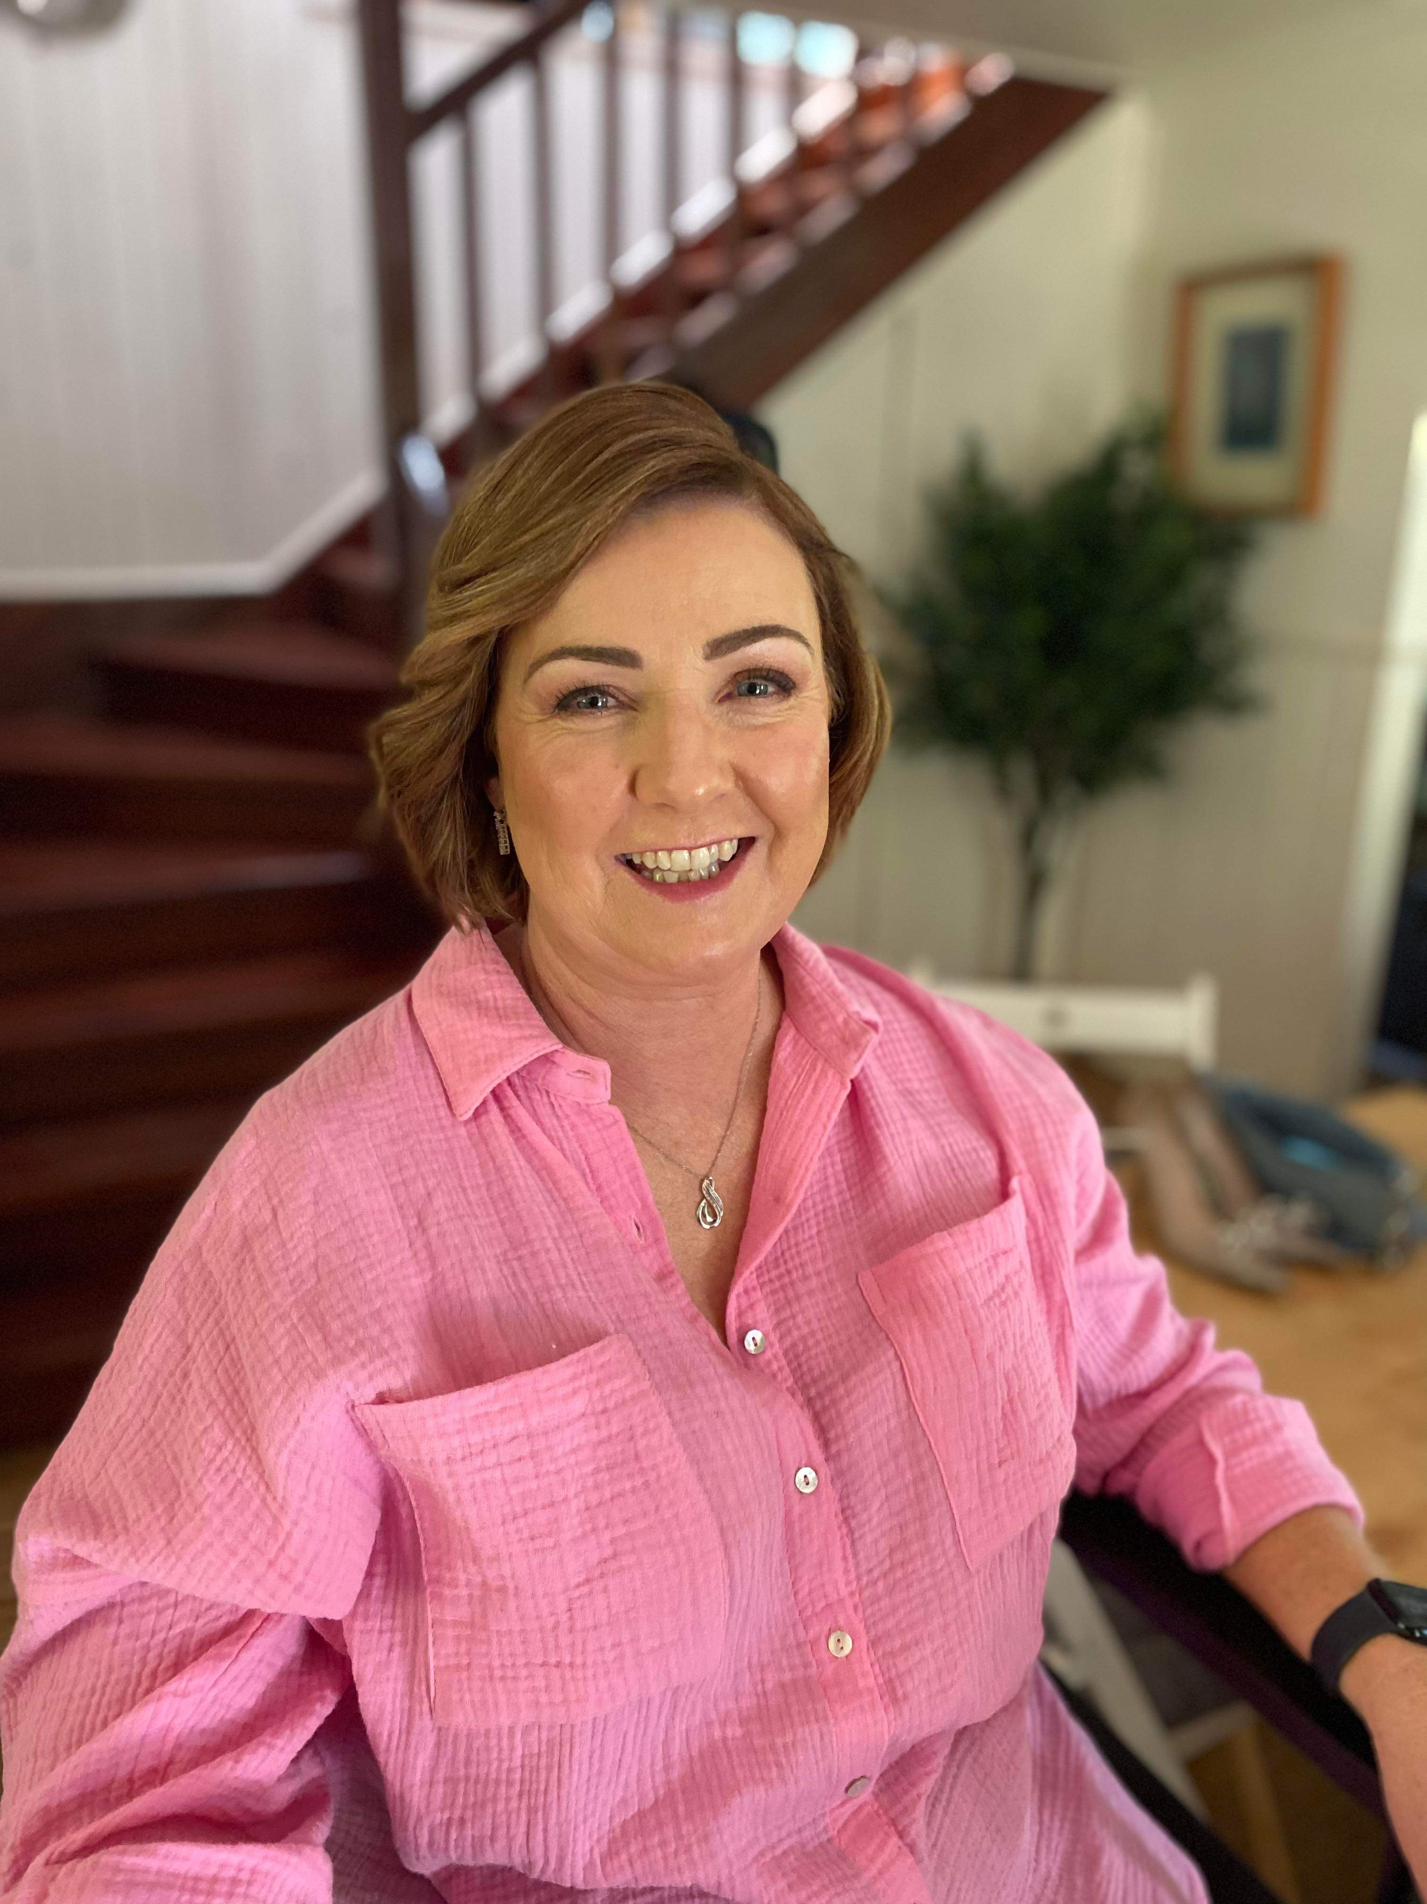
Meet Mrs North
All about your
Assistant Principal

Slide 2
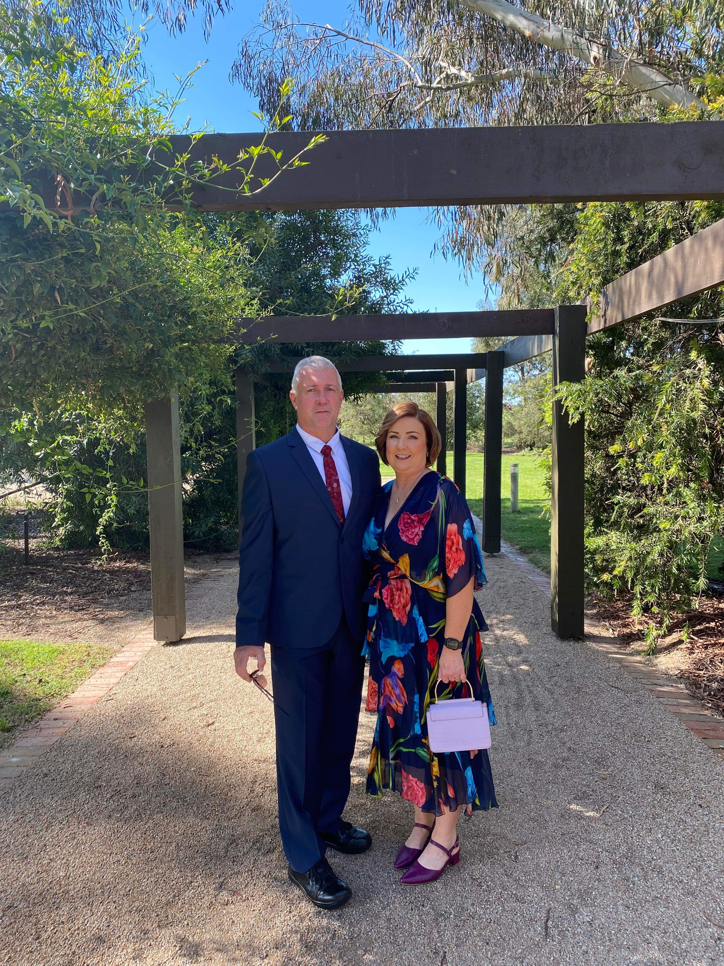
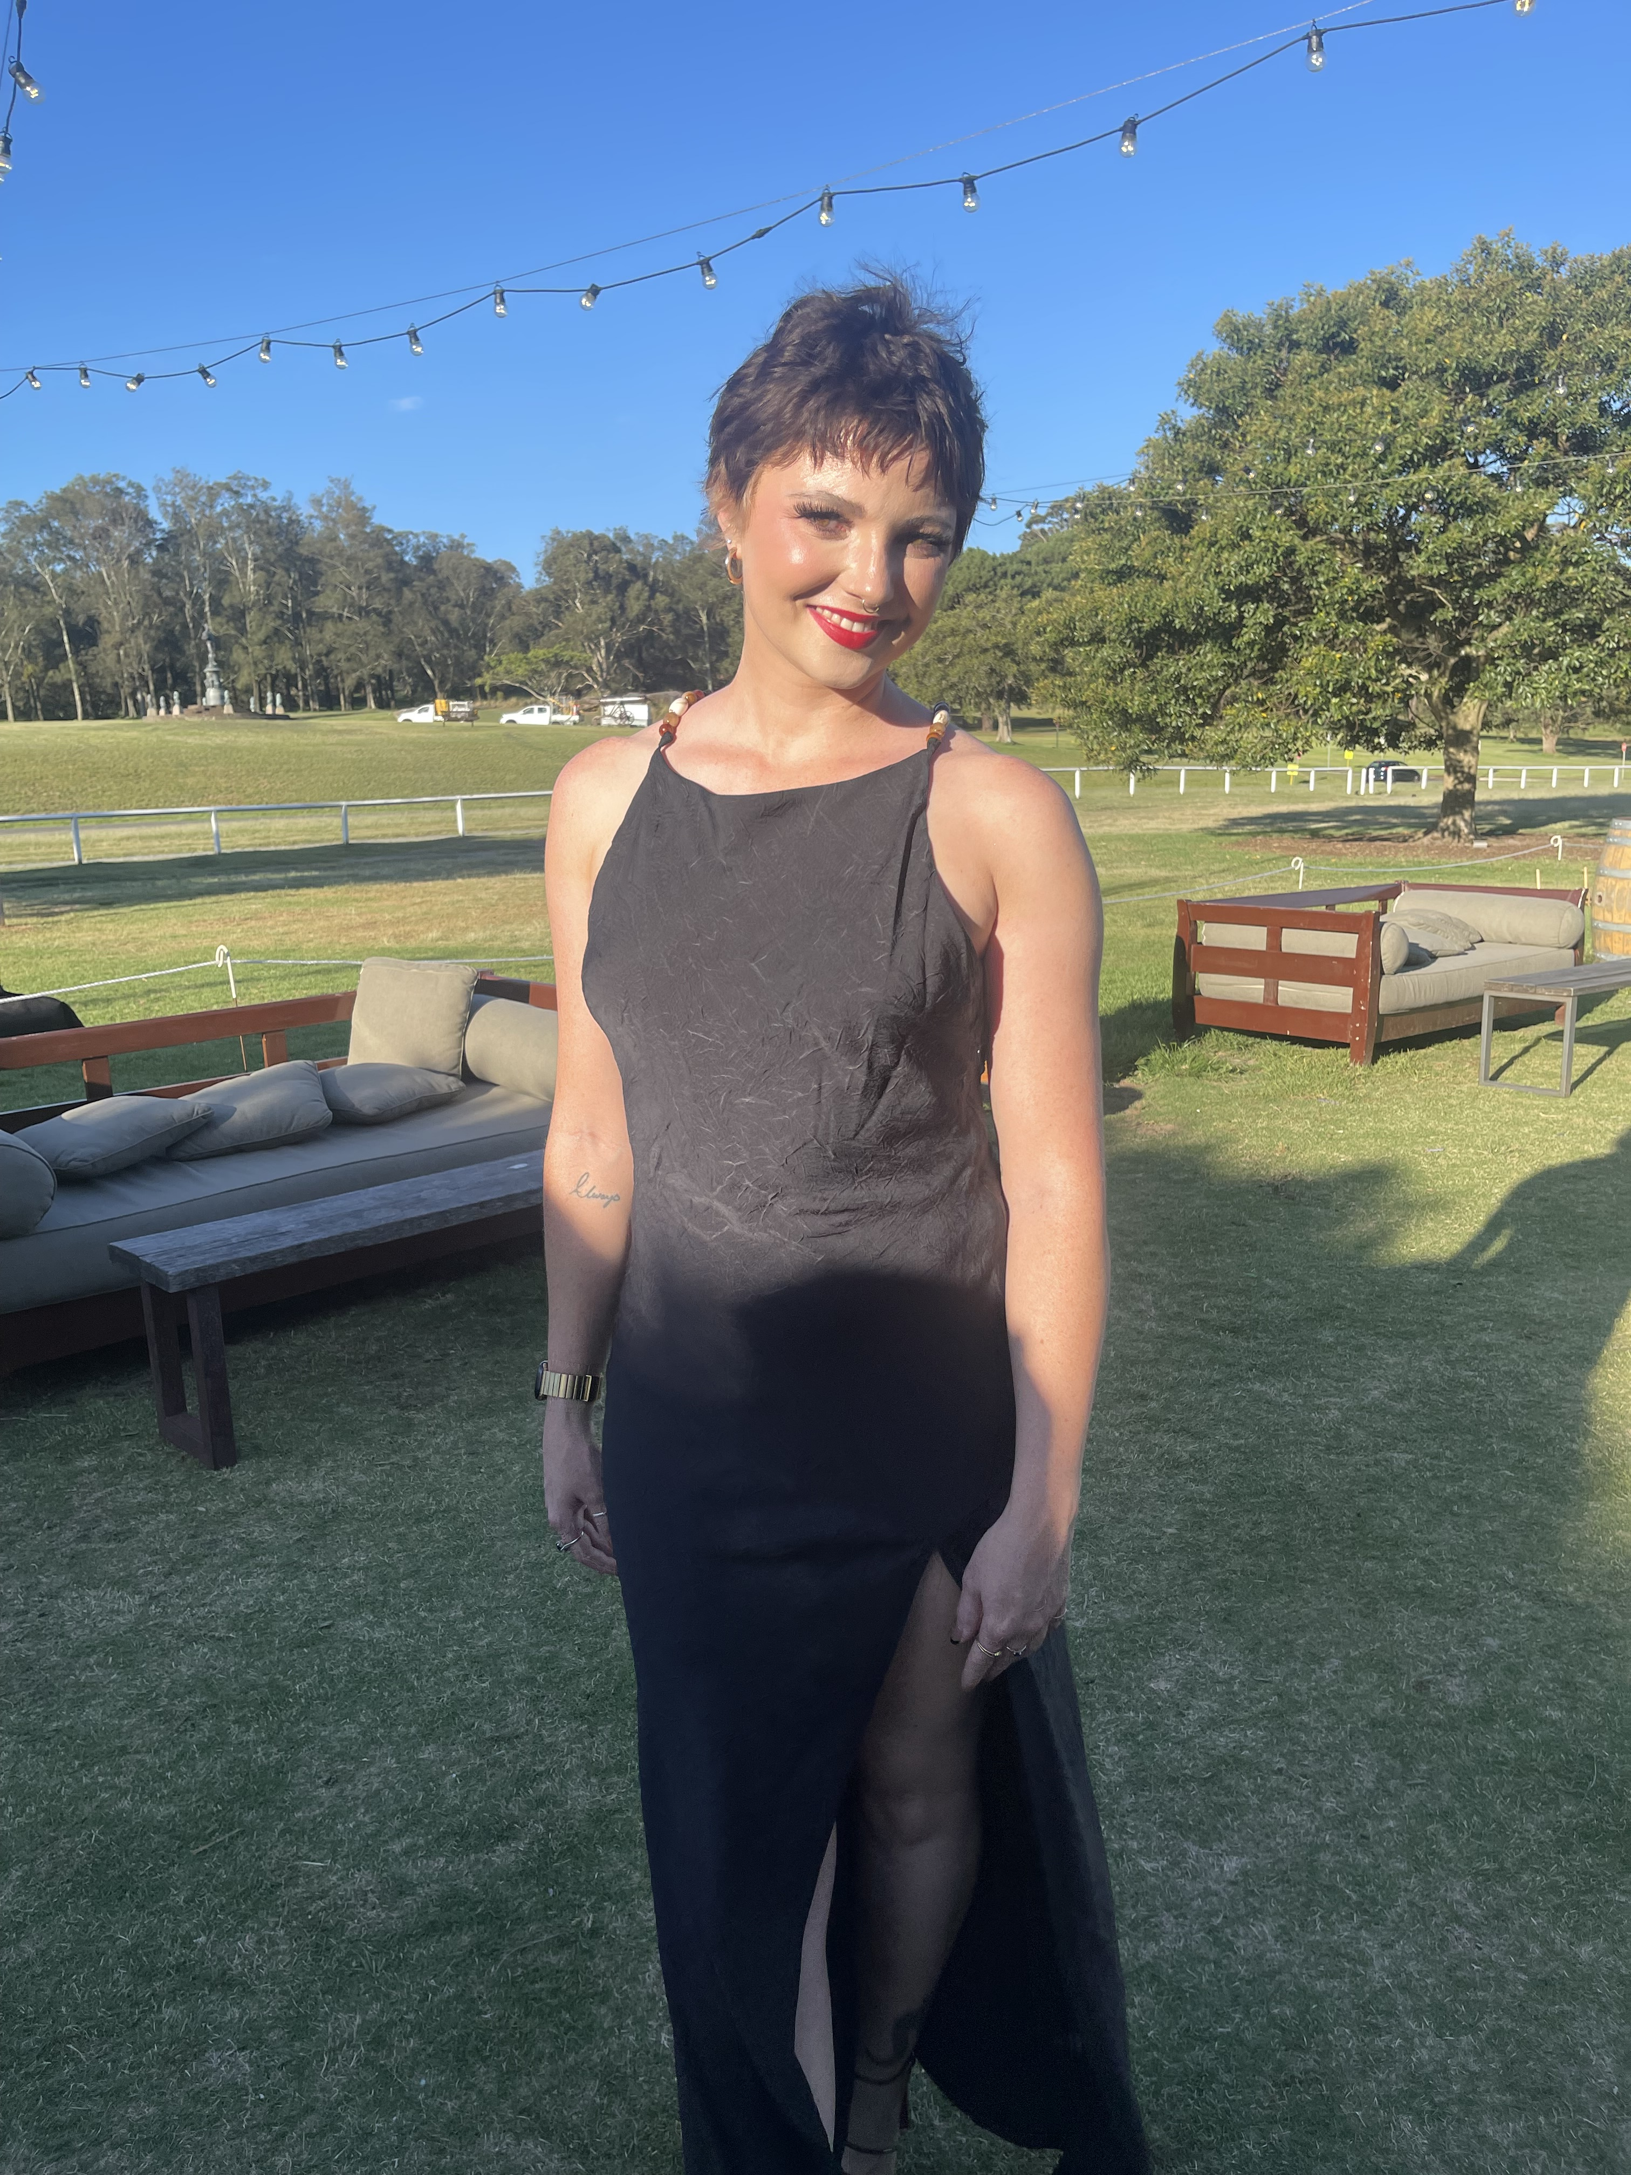
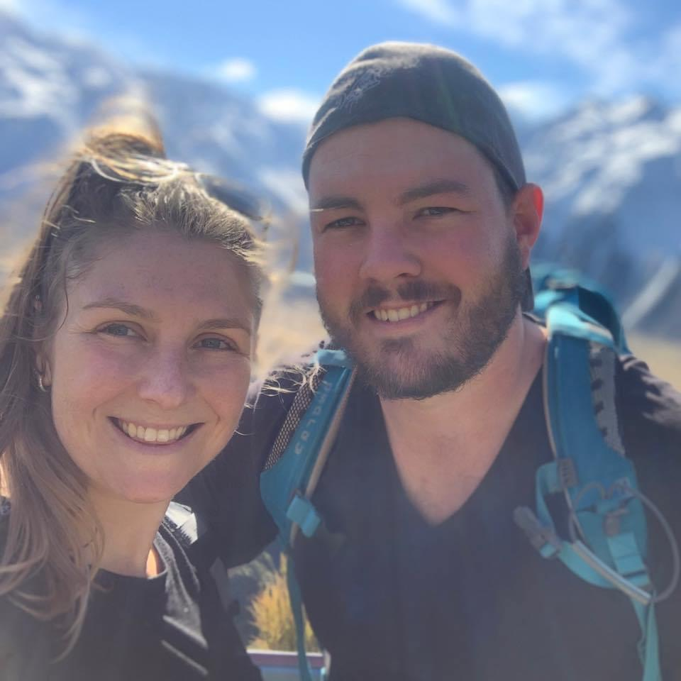
My Family
My husband and I have two children who are grown ups. Sarah is currently completing a law degree. Our son is 28 and most Windsor South families already know him, Mr. North; he is a teacher at Windsor South Public School. Matt is married to his beautiful wife Emma.

Slide 3
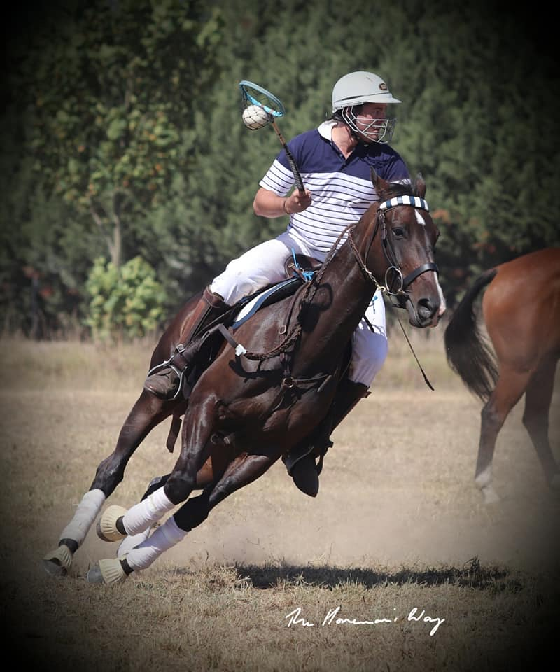
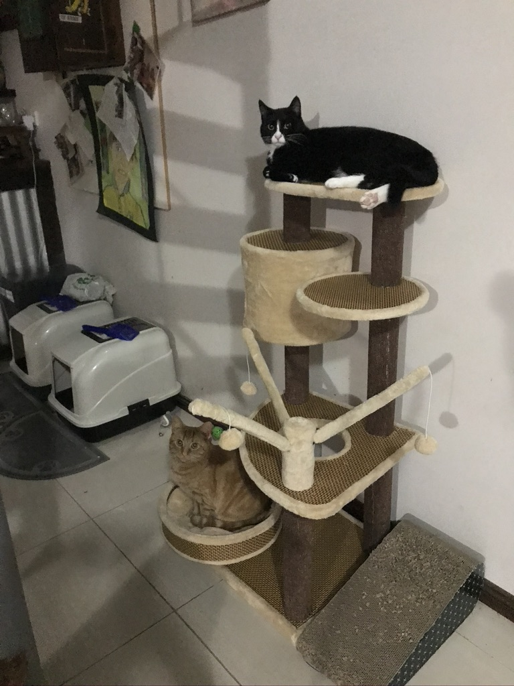
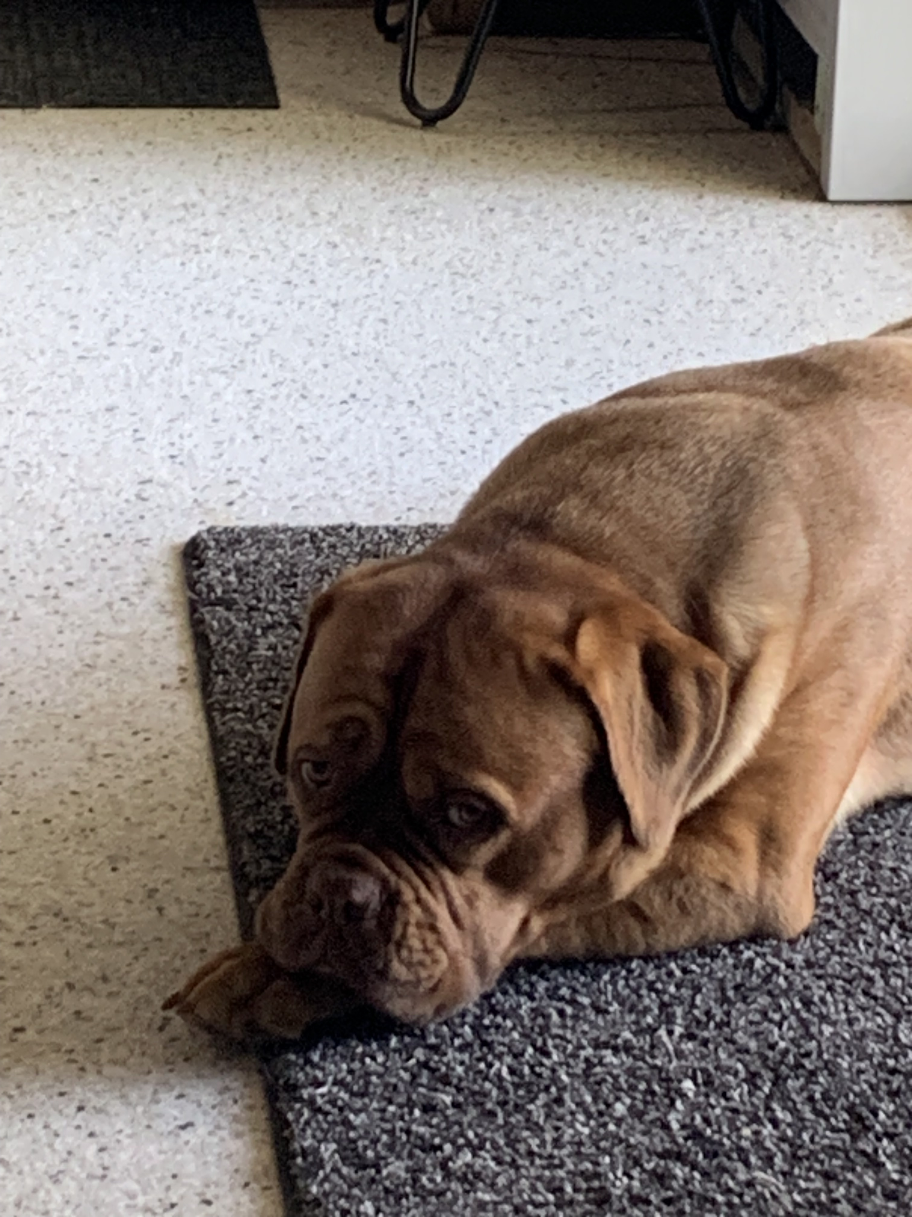
My Pets
Our family has 4 horses, a gorgeous dog and 2 cats. I have always had pets, and they are my best buddies; I love to chat and play with them when I get home from work. They are great listeners, and enjoy a scratch and a pat. My dog ‘Bear’ keeps me busy, and he is super protective of his Mum. He is 2 and loves to go for walks at the park. My cats are Siggy and Ginny, and they spend most their time sleeping or hissing at Bear.

Slide 4
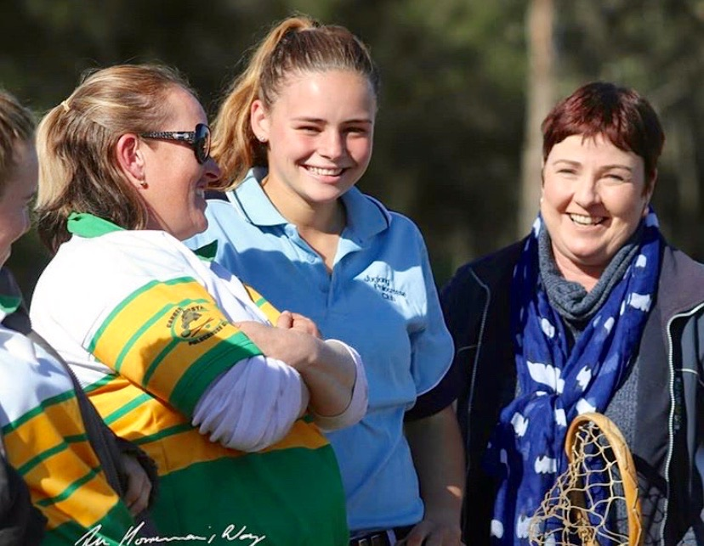
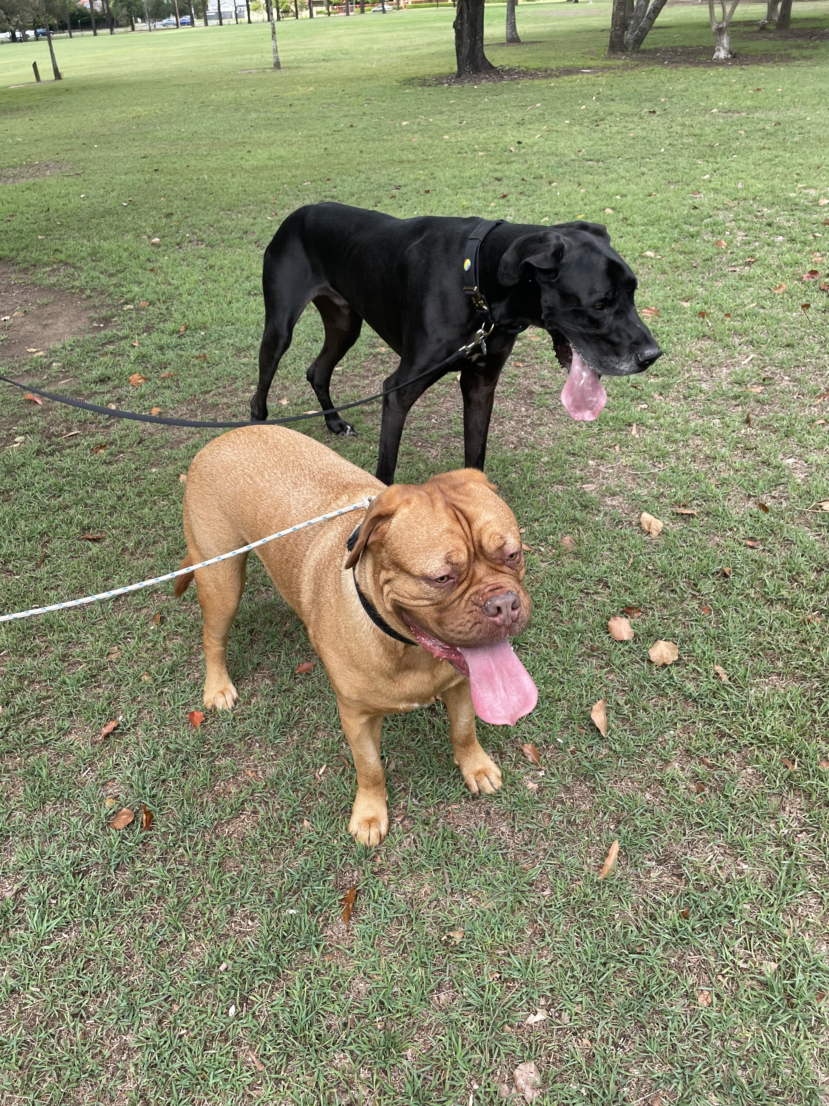
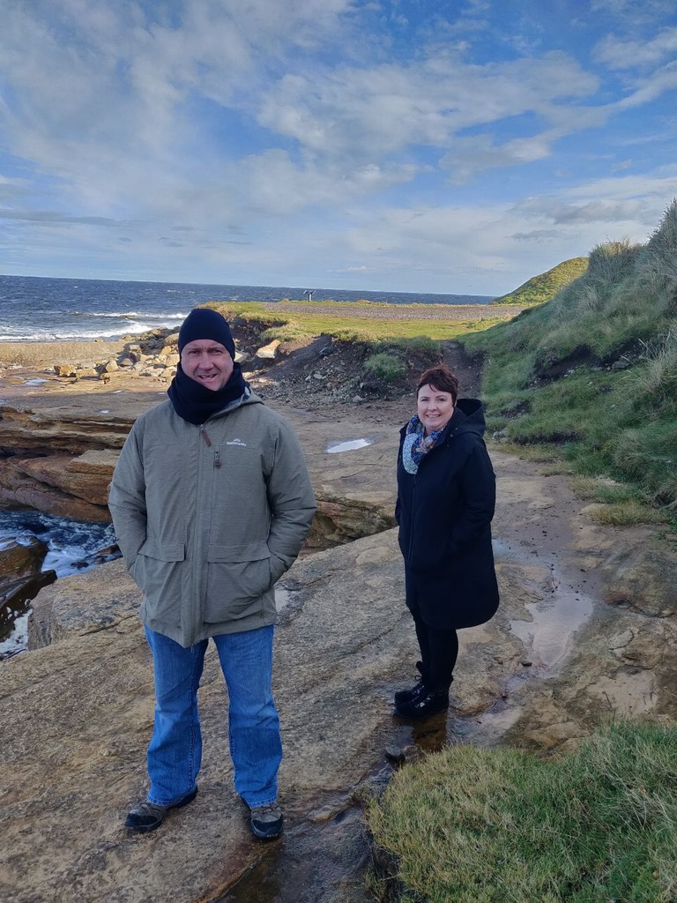
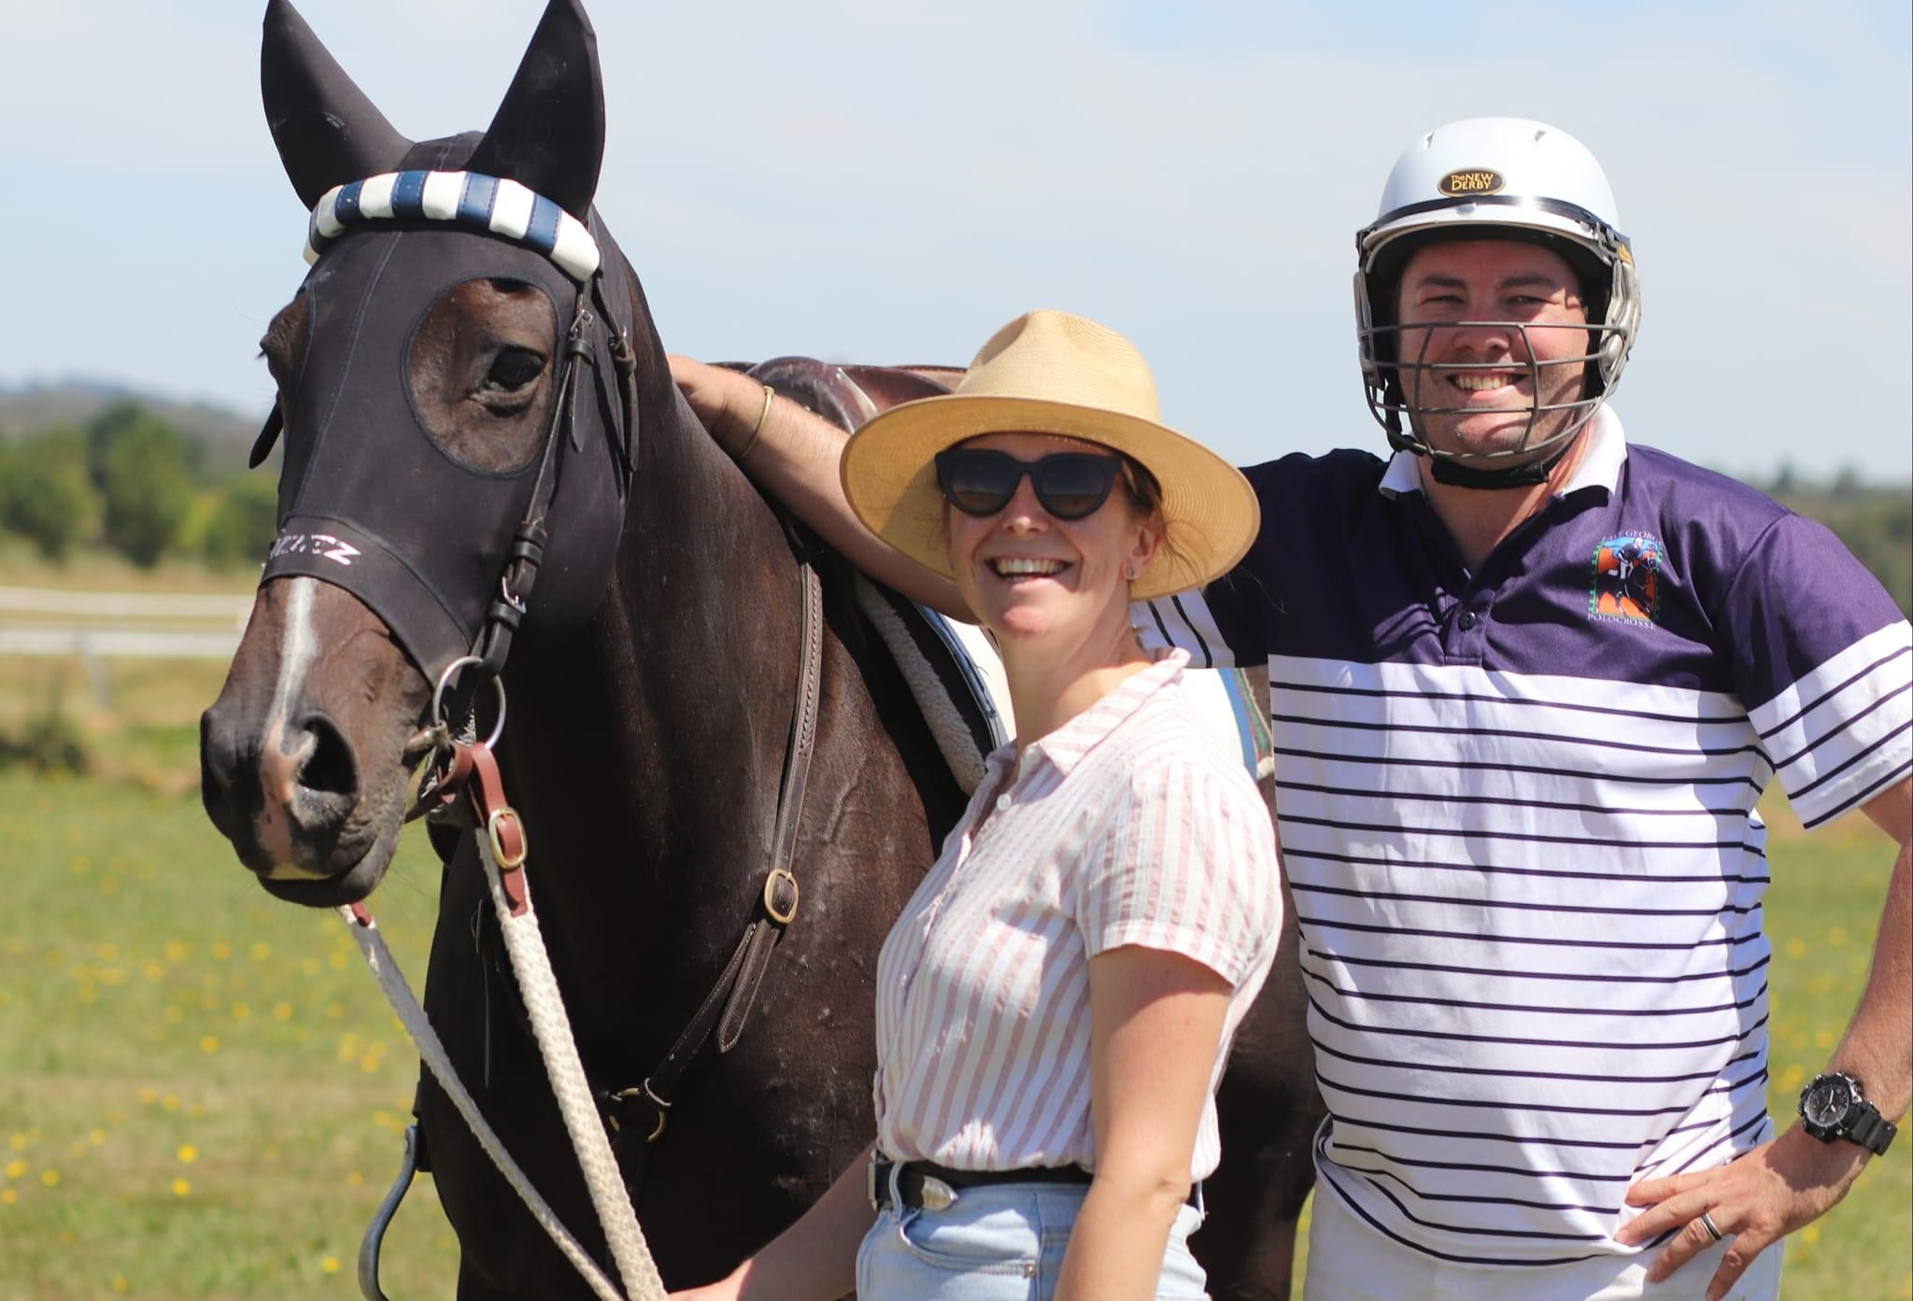
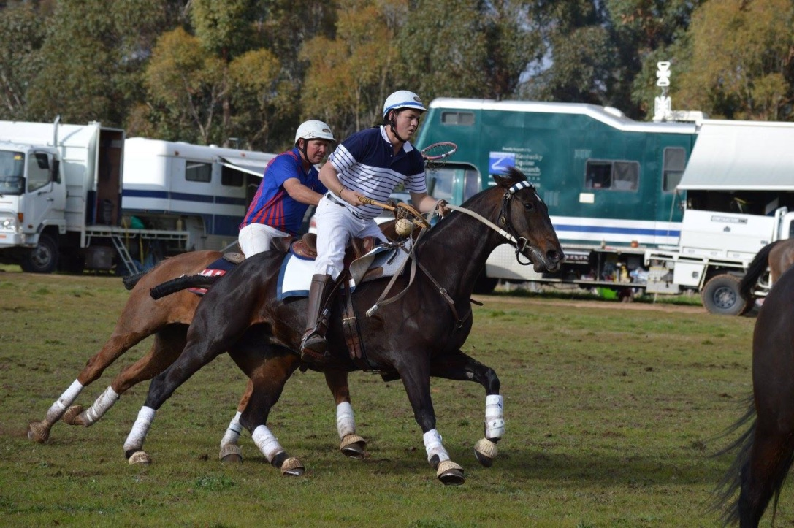
Hobbies and Interests
When I’m not at school, I spend time with my friends and family. Spending time with friends is very important to me. I love going to restaurants for delicious meals –yummy food is the best! I enjoy going to Polo Crosse to watch Matt and Emma play. I love watching Australia play cricket. Travelling is something both my husband and I love. I enjoy walking Bear at the park.

Slide 5
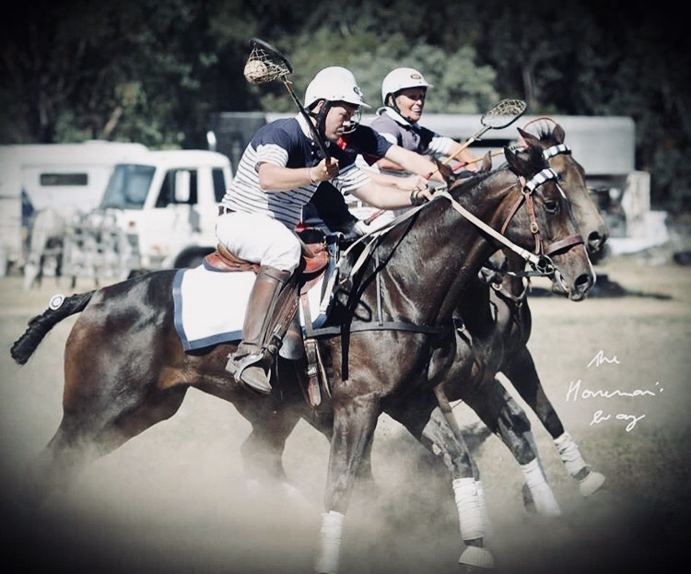
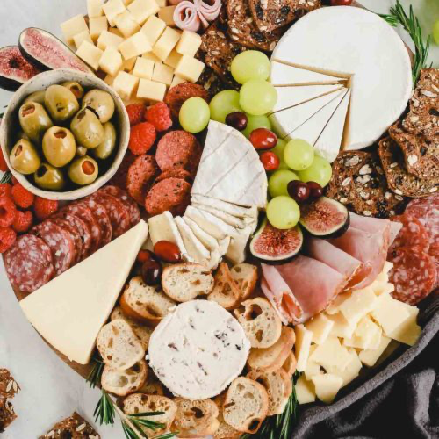
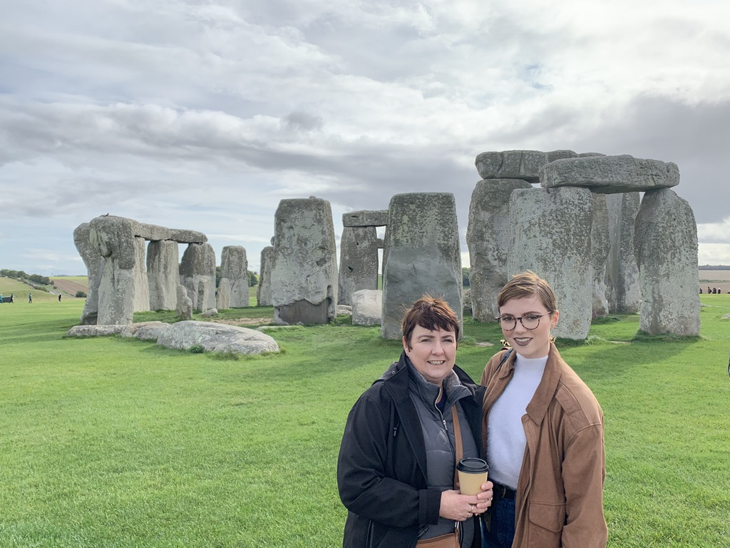
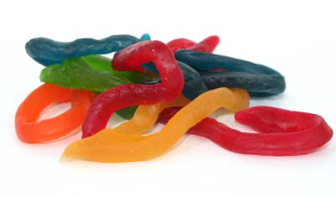
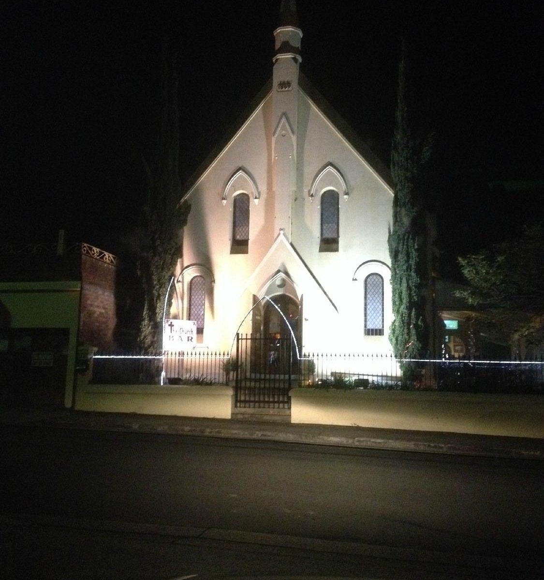
My Favourite Things
Food –Antipasto plate
Colour -Purple
Animal – Horses
Sweet treat- Snakes – not real ones
Country to visit - England and Scotland
Movie - Forrest Gump
Restaurant – The Church Bar
Shopping - Ikea

Slide 6
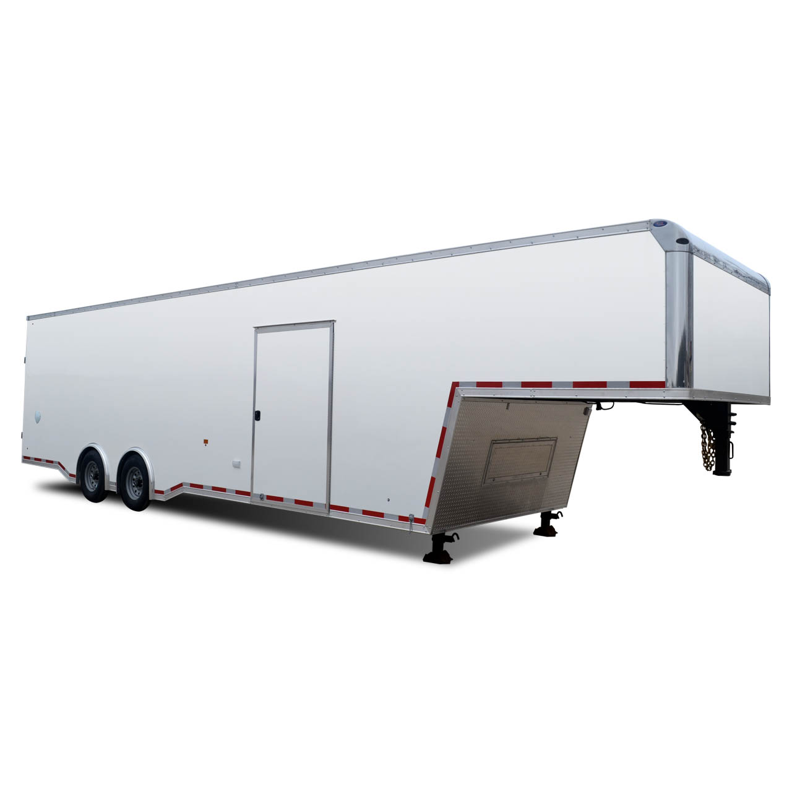
Fun facts about Me!
I love horse riding, and we have a new horse which I am looking forward to riding
I can not ride a motorbike
I am terrified of flying in planes and of snakes
I do enjoy a sleep in on the holidays, and I love to read a good book with a coffee
I like gardening, especially growing my own vegetables
I love dressing up for special days at school
I can drive a truck and tow a gooseneck trailer

Slide 7
2024 is going to be an incredible year!
I am so excited to be an Assistant Principal at Windsor South Public School. I cannot wait to be back at school with my new class ready for a year of fun , learning and adventure. I love getting to know my new students, their families, and to share my passion for learning with them.

