Slide 1
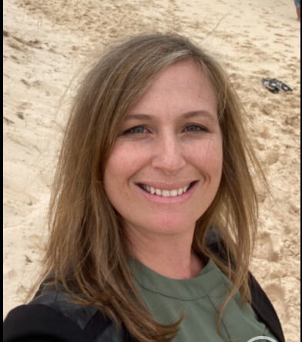
Meet
Mrs Carter
All about our Assistant Principal Curriculum & Instruction

Slide 2
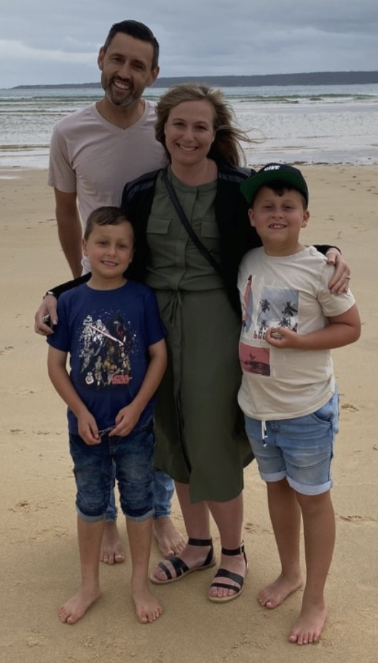
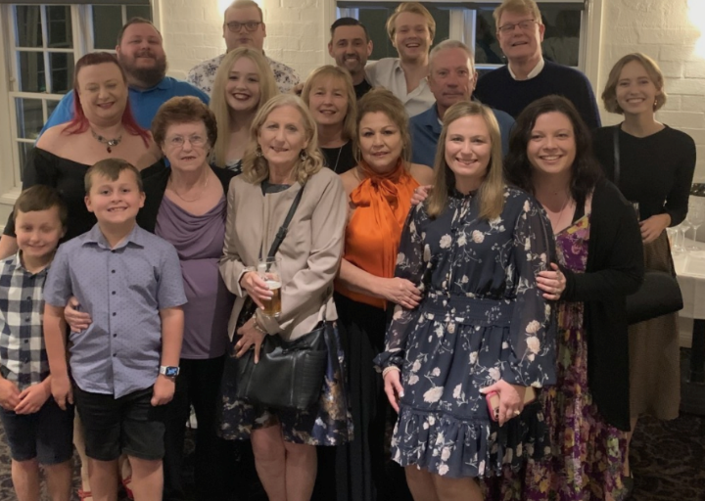
My Family
I am married with two cheeky but beautiful boys. Bailey is 14 and Lochie is 11. My husband Matt and I will have our 18-year wedding anniversary this year! I grew up in Penrith and now live in Blaxland, which is part of the Blue Mountains.
My family meets weekly and my Gran cooks for whoever can make it. We call it tribe night and it’s always noisy but it’s the best!!!!

Slide 3
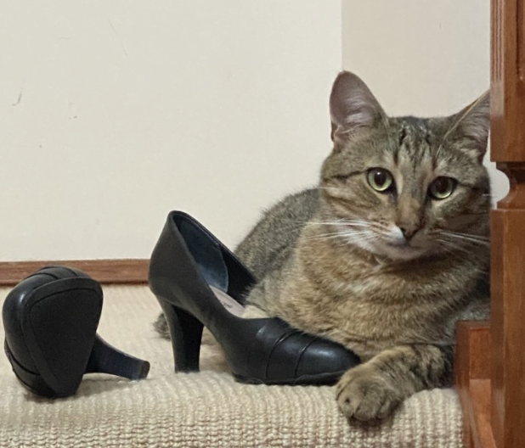
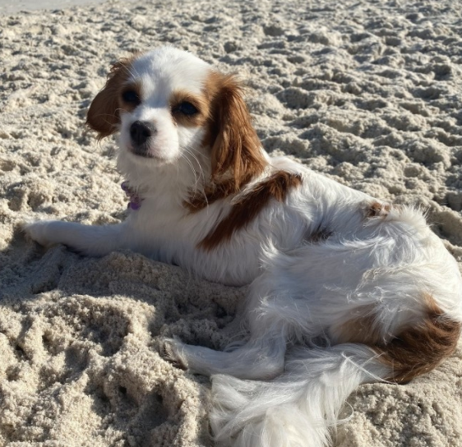
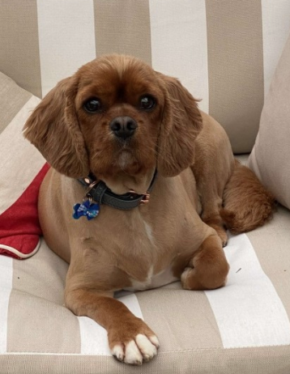
My Pets
I have one cat, Ninja who loves my shoes! If I leave them lying about, Ninja will be found with his paw tucked inside! Ninja is a rescue cat who was found with his brothers and sisters under a school building. Minnie is our little Cavalier Cross and Monte is a King Charles Cavalier. They are my fur babies, and I love them dearly. Minnie and Monte are inseparable and enjoy lots of snuggles on the lounge.

Slide 4
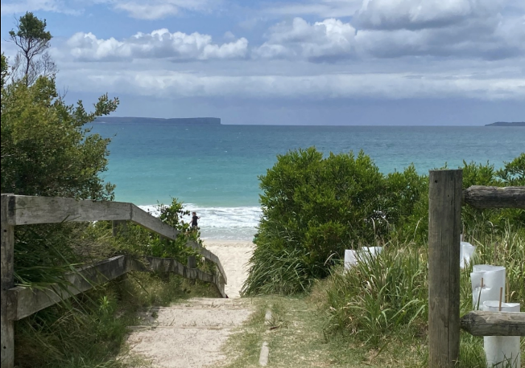
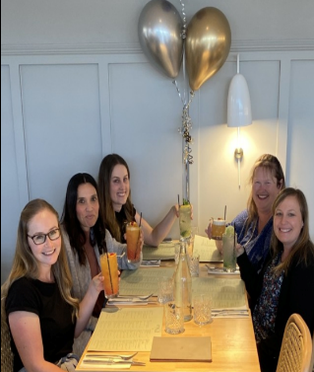
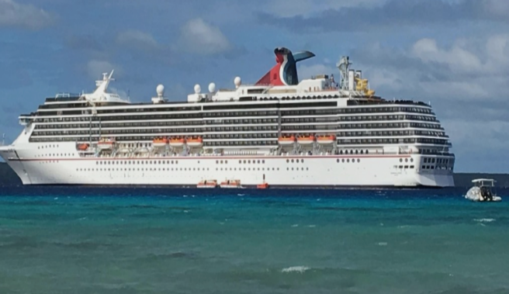
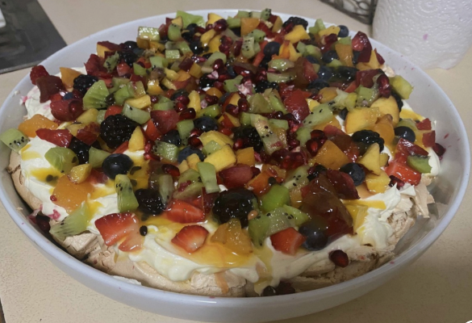
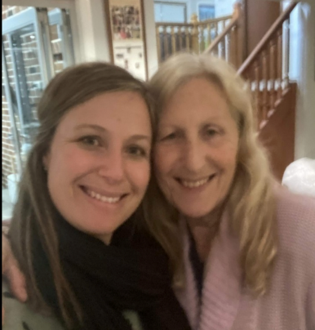
Hobbies & Interests
The beach is my happy place, and I visit my mum and dad regularly on the South Coast. Nelson Beach in Vincentia is my favourite spot. I love to cruise and have been twice with Matt and the boys to the South Pacific Islands. I really enjoy spending time with my mum who I see every school holidays. I also love to cook and catch up with friends and family at different restaurants and cafes. I relax by binge watching different series curled up on the lounge!

Slide 5
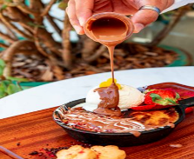
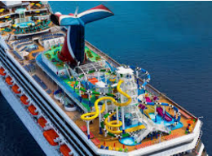
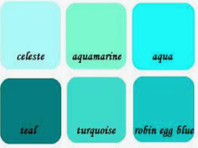
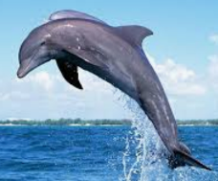
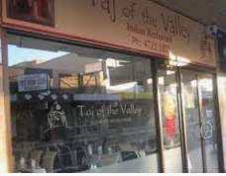
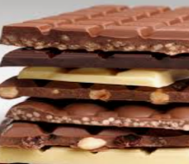
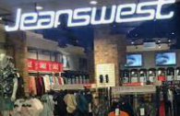
My Favourites
Desserts! At the moment I am loving the biscoff baked cookie at Emu Hall and Messina ice-cream!
I would love to cruise to the Northeast Coast of Australia-The Whitsundays/Airlie Beach.
I like sea greens and blues but also pink and yellow!
I like so many movies it’s hard to choose! P.S I Love you is one of my favourites.
I love dolphins and have been lucky enough to swim with them at SeaWorld!
Taj of the Valley in Penrith is an amazing Indian restaurant.
I would choose chocolate over candy, and I enjoy anything that has caramel in it!
I like Jeanswest for casual wear and Jacquie-E for work :D

Slide 6
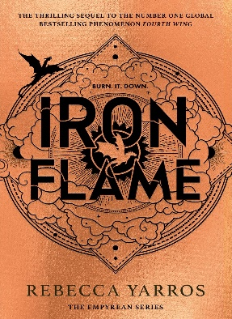
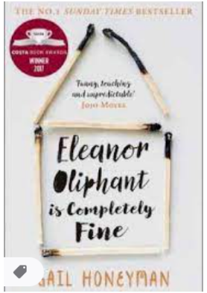
Reading Rocks !
I really enjoy reading especially in holiday times. At the moment I am reading Iron Flame by Rebecca Yarros. Mrs Bristol has got me into the fantasy genre! I also love reading true stories about people who have overcome hardship and fictional stories that have an unexpected twist at the end. Reading is something I would like to make more time to do !

Slide 7
Fun Facts About Me !
I am a neat freak and like everything to be in its place
You will always see me with a coffee in hand!
This is my 21st year in teaching
I have had surfing lessons
I like staying up late and sleeping in
I learnt karate as a teenager
I am really shy and get nervous easily!!!!
I am a HAT-I have achieved my Highly Accomplished Teaching Accreditation
Broccoli is my favourite vegetable, and I don’t like brussel sprouts
I am scared of snakes
I love learning about how to be the best teacher I can be
My favourite flower is a frangipani

Slide 8
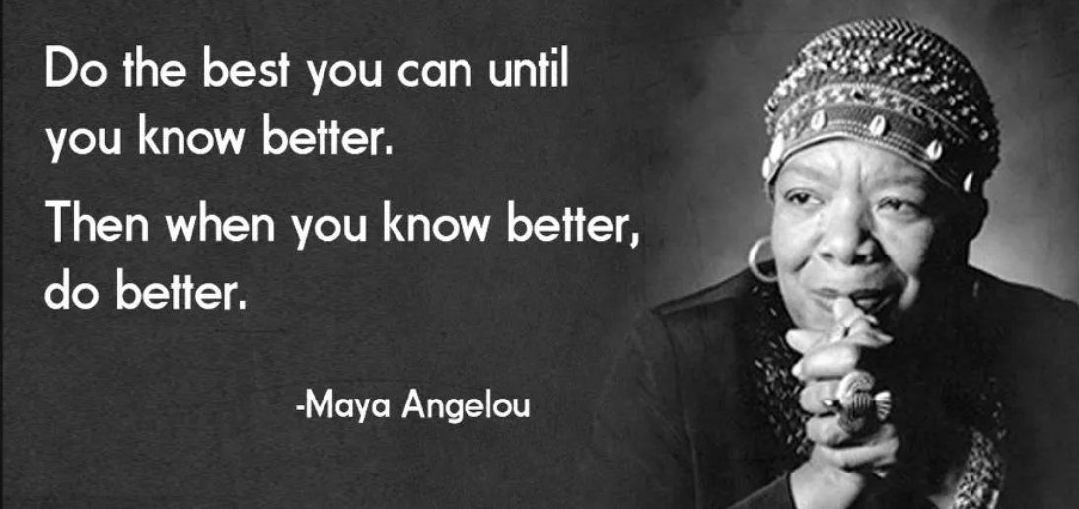
I will make mistakes but will always work hard to be the best I can be for the students, staff and community of Windsor South P.S
I am looking forward to seeing all our Southie families for an amazing 2025!

