Slide 1
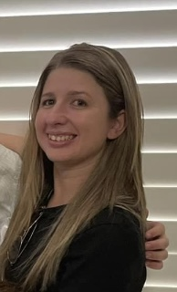
School admin officer
Meet Mrs Galea

Slide 2
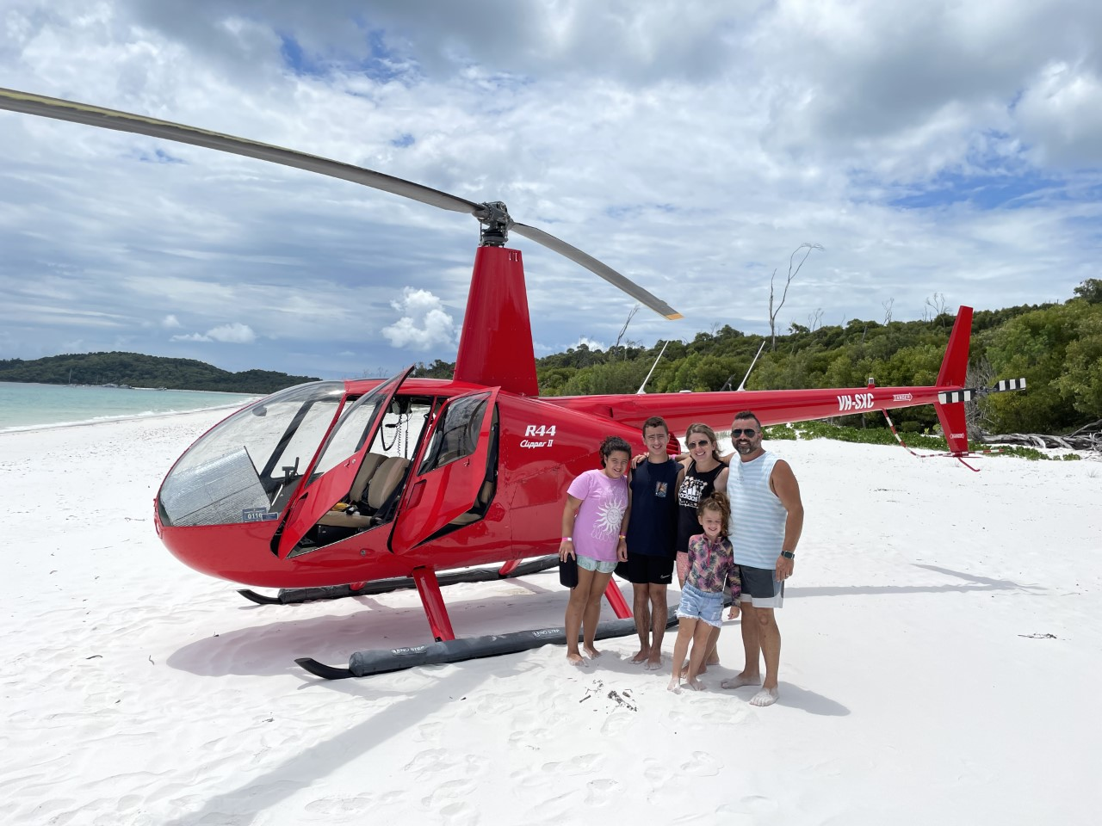
My family
I am married to the love of my life Phil for 14 years. We have 3 children Joel who is 12 years old, Sophie who is 10 years old and Ellie who is 5 years old.
Being a family means you are part of something very wonderful. It means you will love and be loved for the rest of your life.

Slide 3
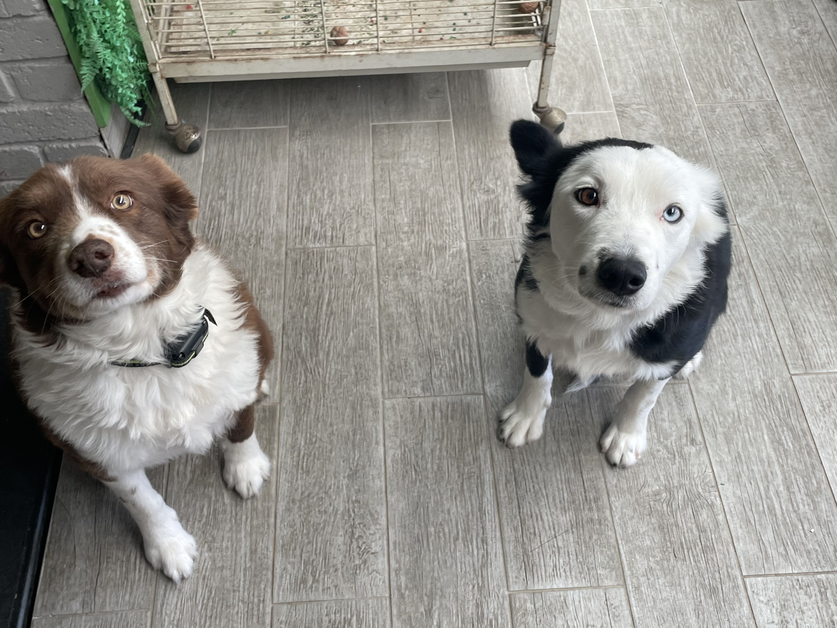
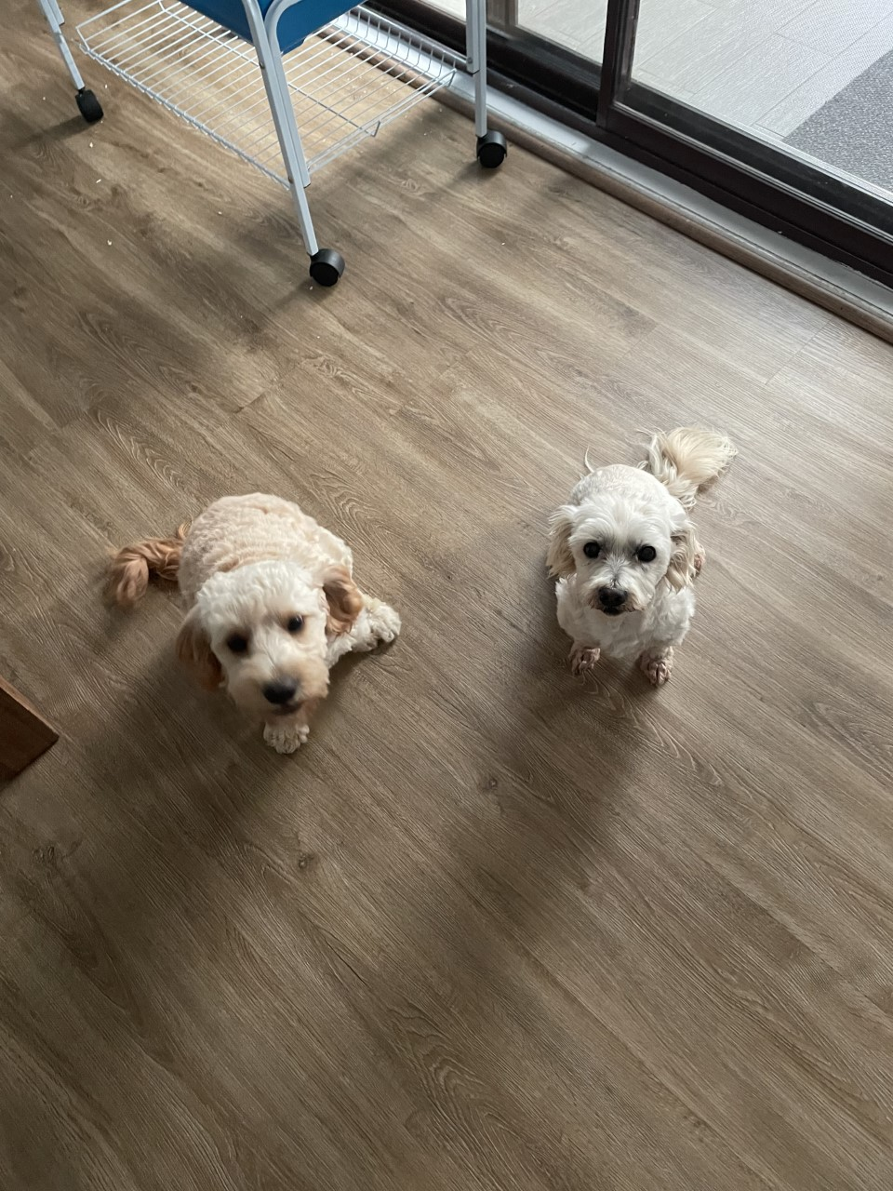
My Pets
I have 4 pet dogs Molly is a 14 year olf Moodle, Leah is a 8 year old Border Collie, Max is a 4 year old Border Collie and Coco is a 2 year old Cavoodle.

Slide 4
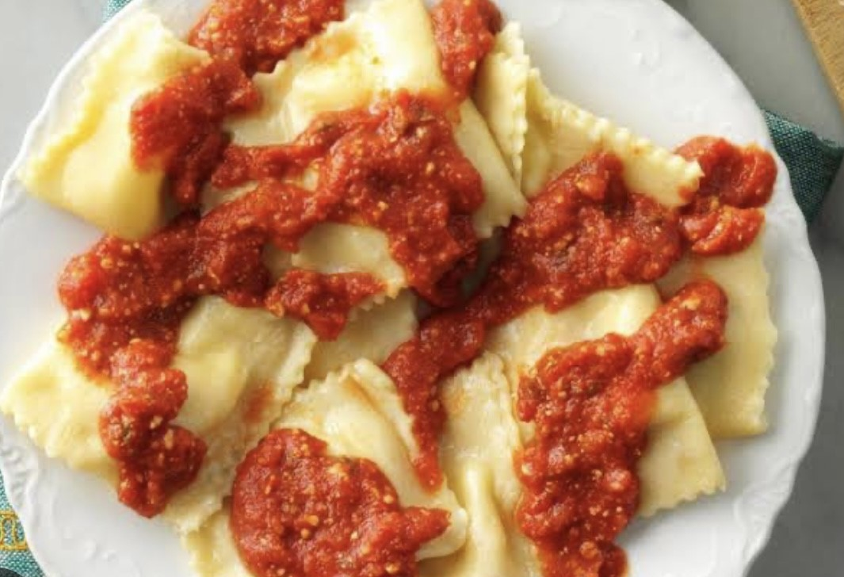
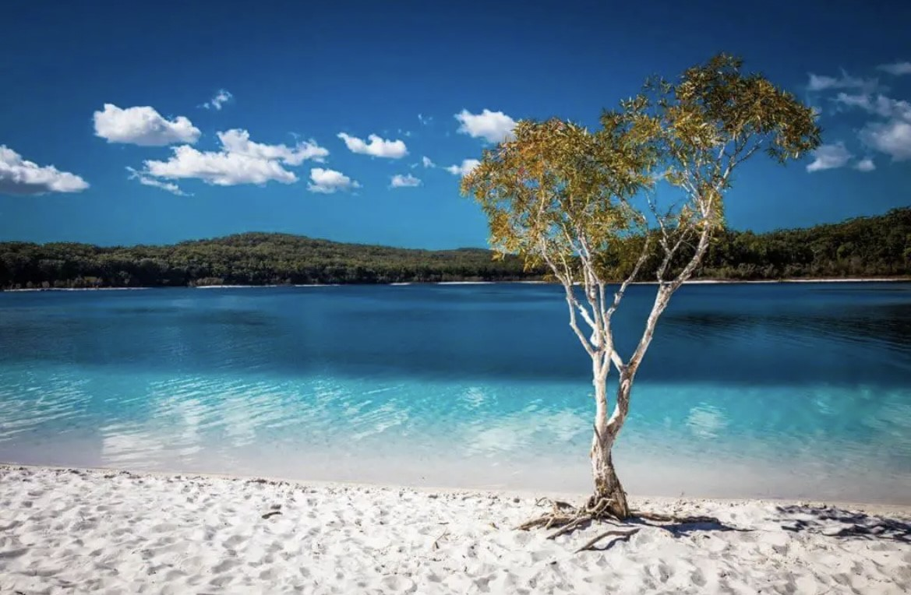
My favorites
Colour: Pink
Food: Ravoli
Movie: Norbit
Place: Fraser Island
Shop: Kmart

Slide 5
I am looking forward to a wonderful year working with you all at Windsor South Public School. May it be the best year yet.

