Slide 1
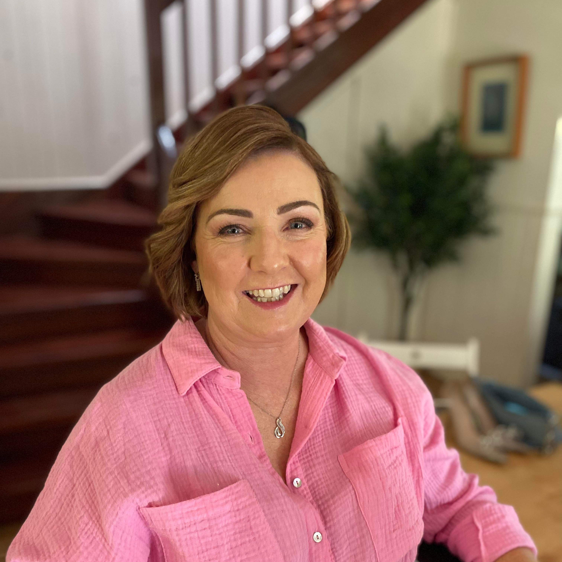
Meet Mrs North
All about your
Assistant Principal

Slide 2
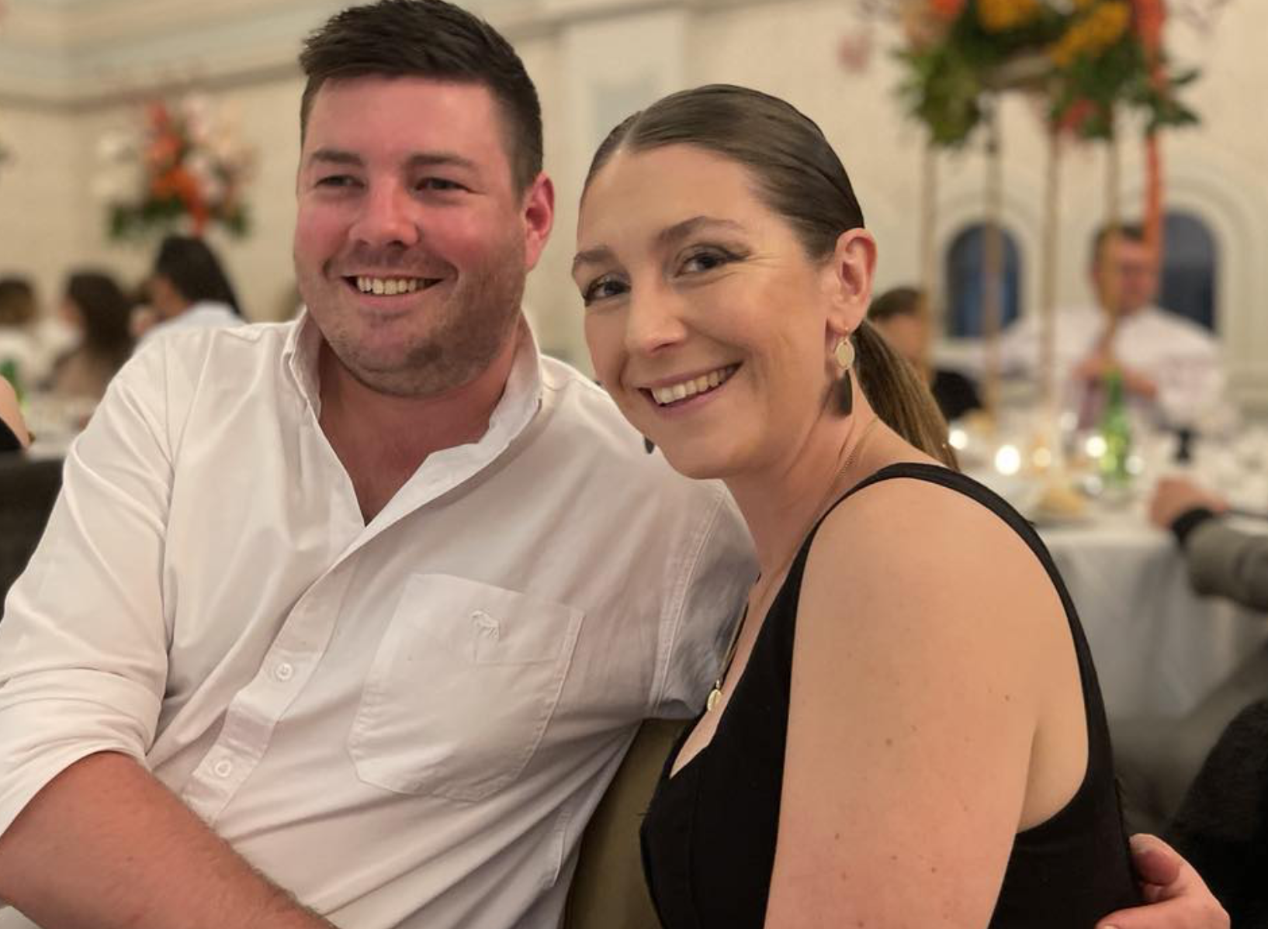
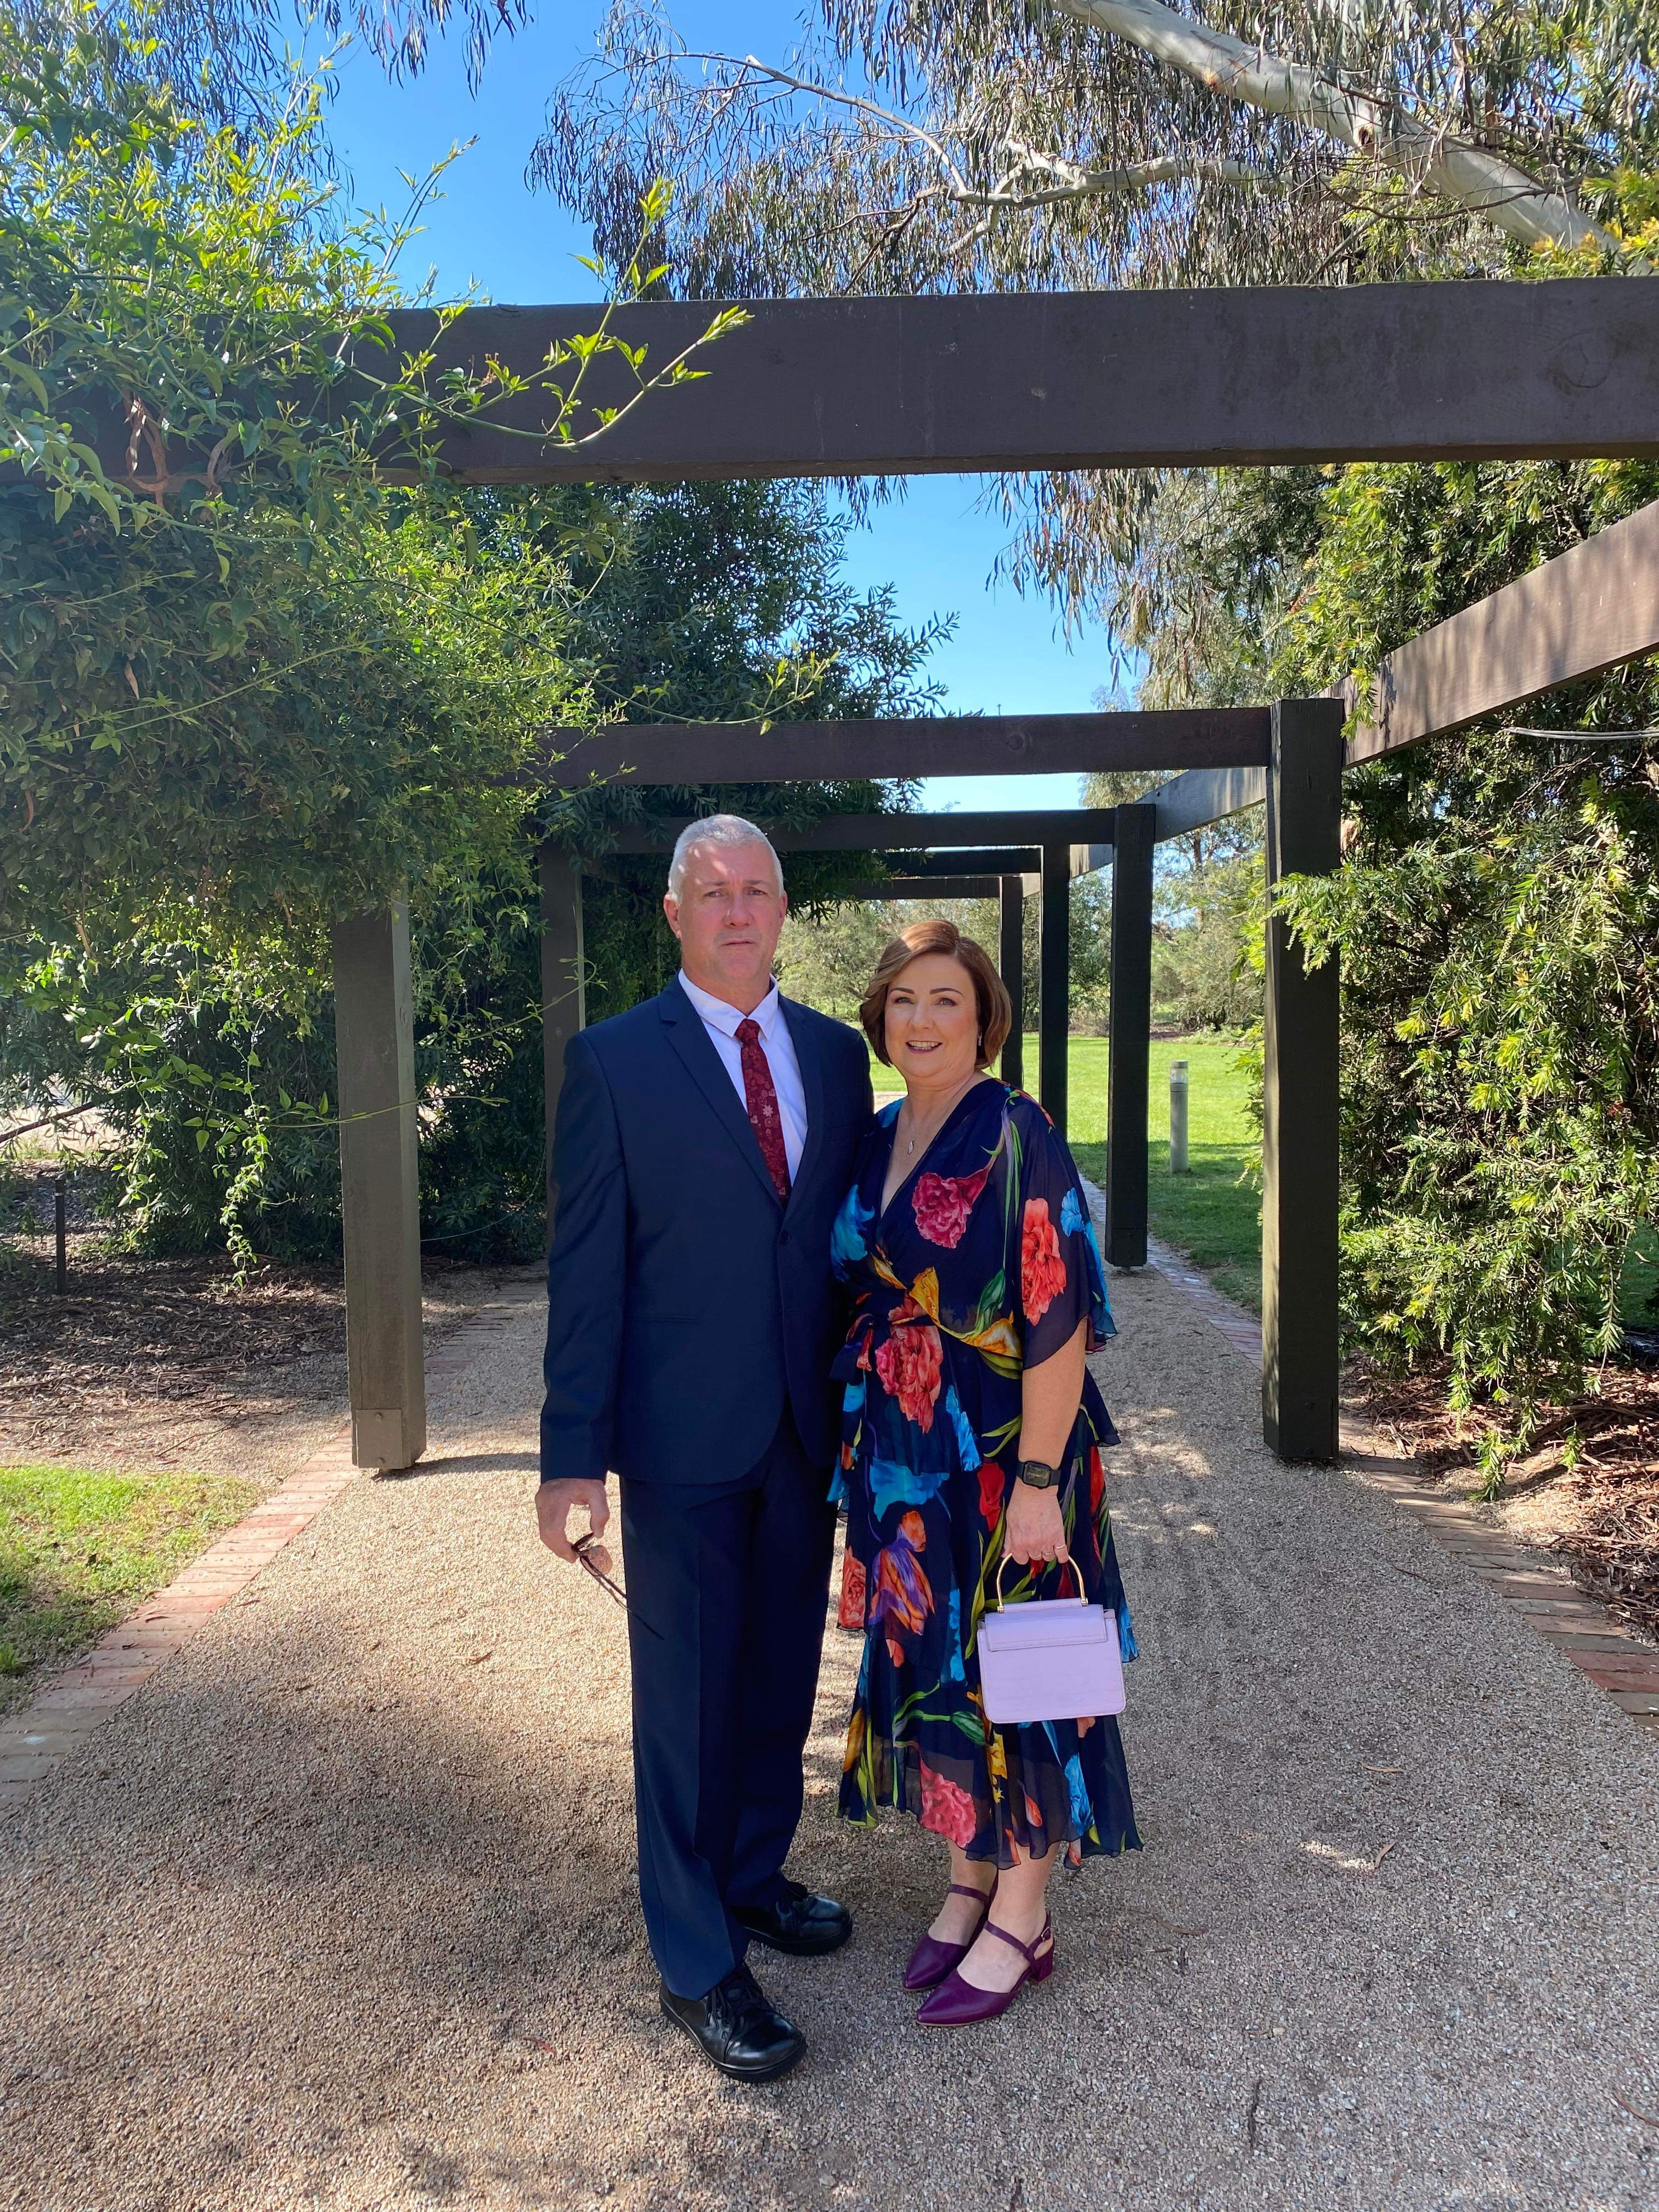
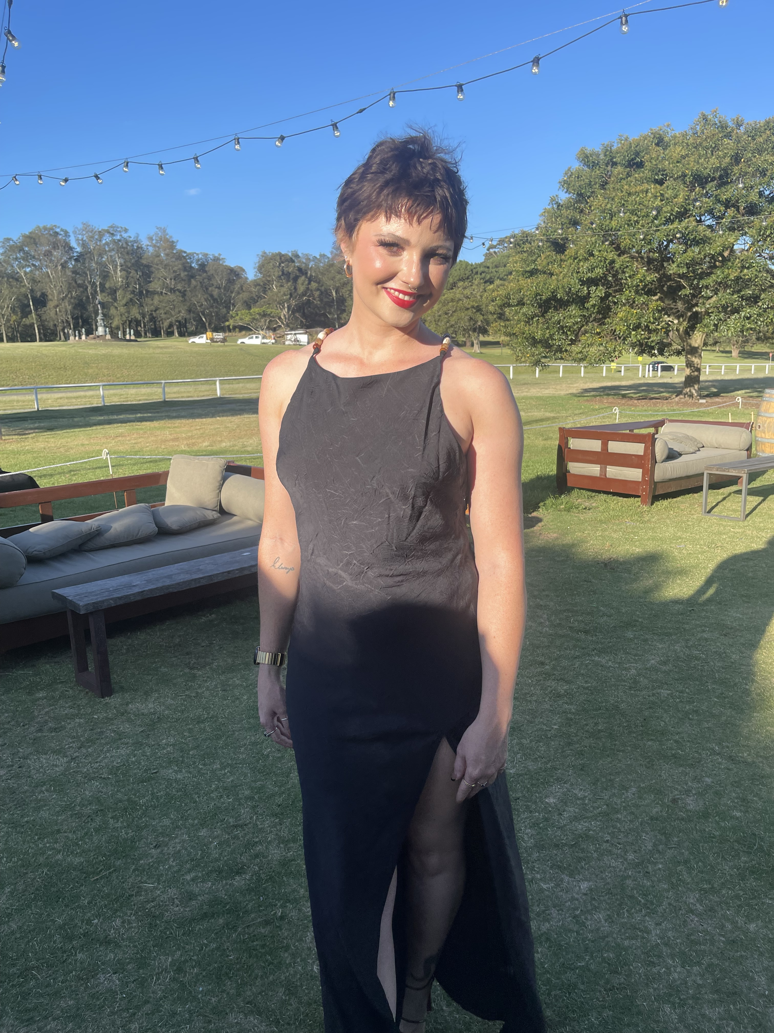
My Family
My husband and I have two children who are grown ups. Sarah works in the city. Our son most of the Windsor South families already know , Mr. North; he is a teacher at Windsor South Public School. I also have a beautiful daughter in law Emma.

Slide 3
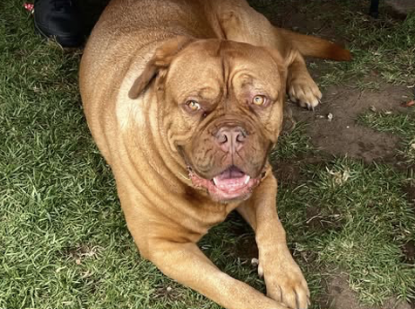
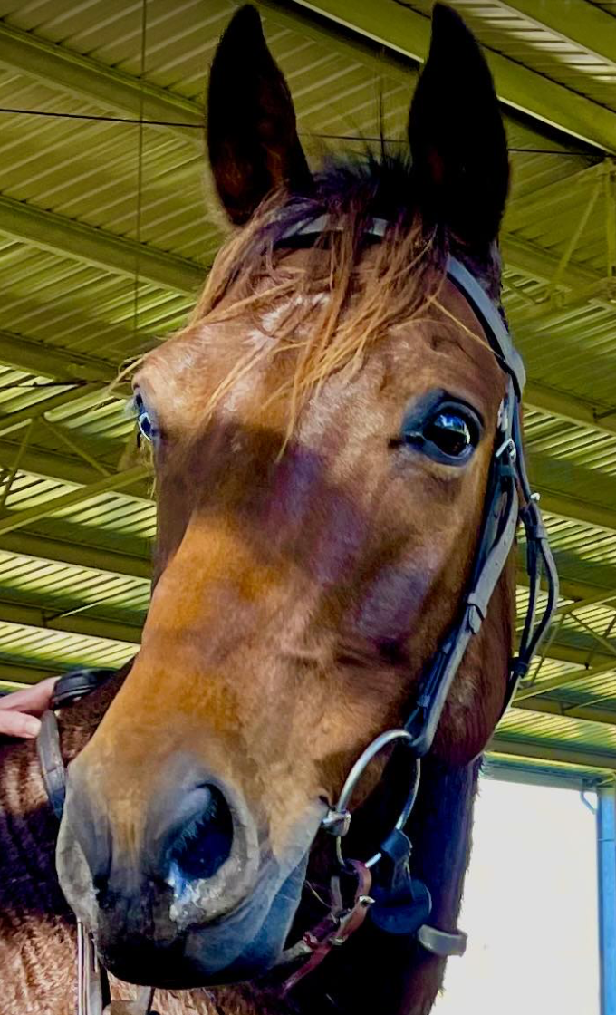
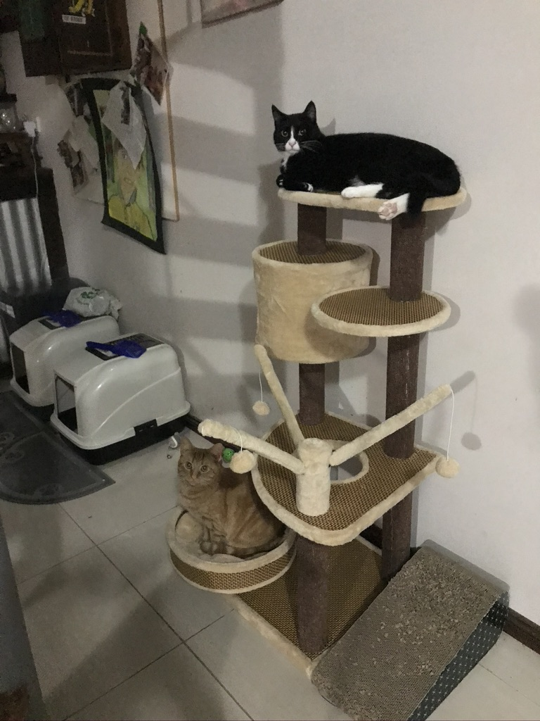
My Pets
Our family has 3 horses, a wonderful dog and 2 funny cats. I have always had pets, and they are my best buddies; I love to chat and play with them, and they are a big part of our family. My dog ‘Bear’ keeps me busy, and he is super protective of his Mum. He is 3 and loves to go for walks at the park. My cats are Siggy and Ginny, and they spend most their time sleeping or hissing at Bear. Our horses are Bundy, Bacardi and Phoenix and they are Australian Stock Horses.

Slide 4
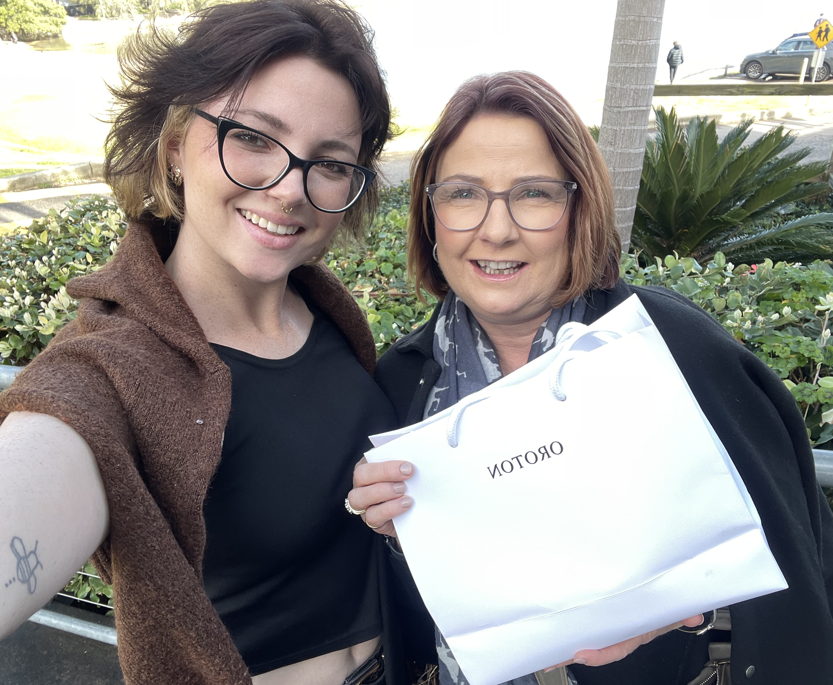
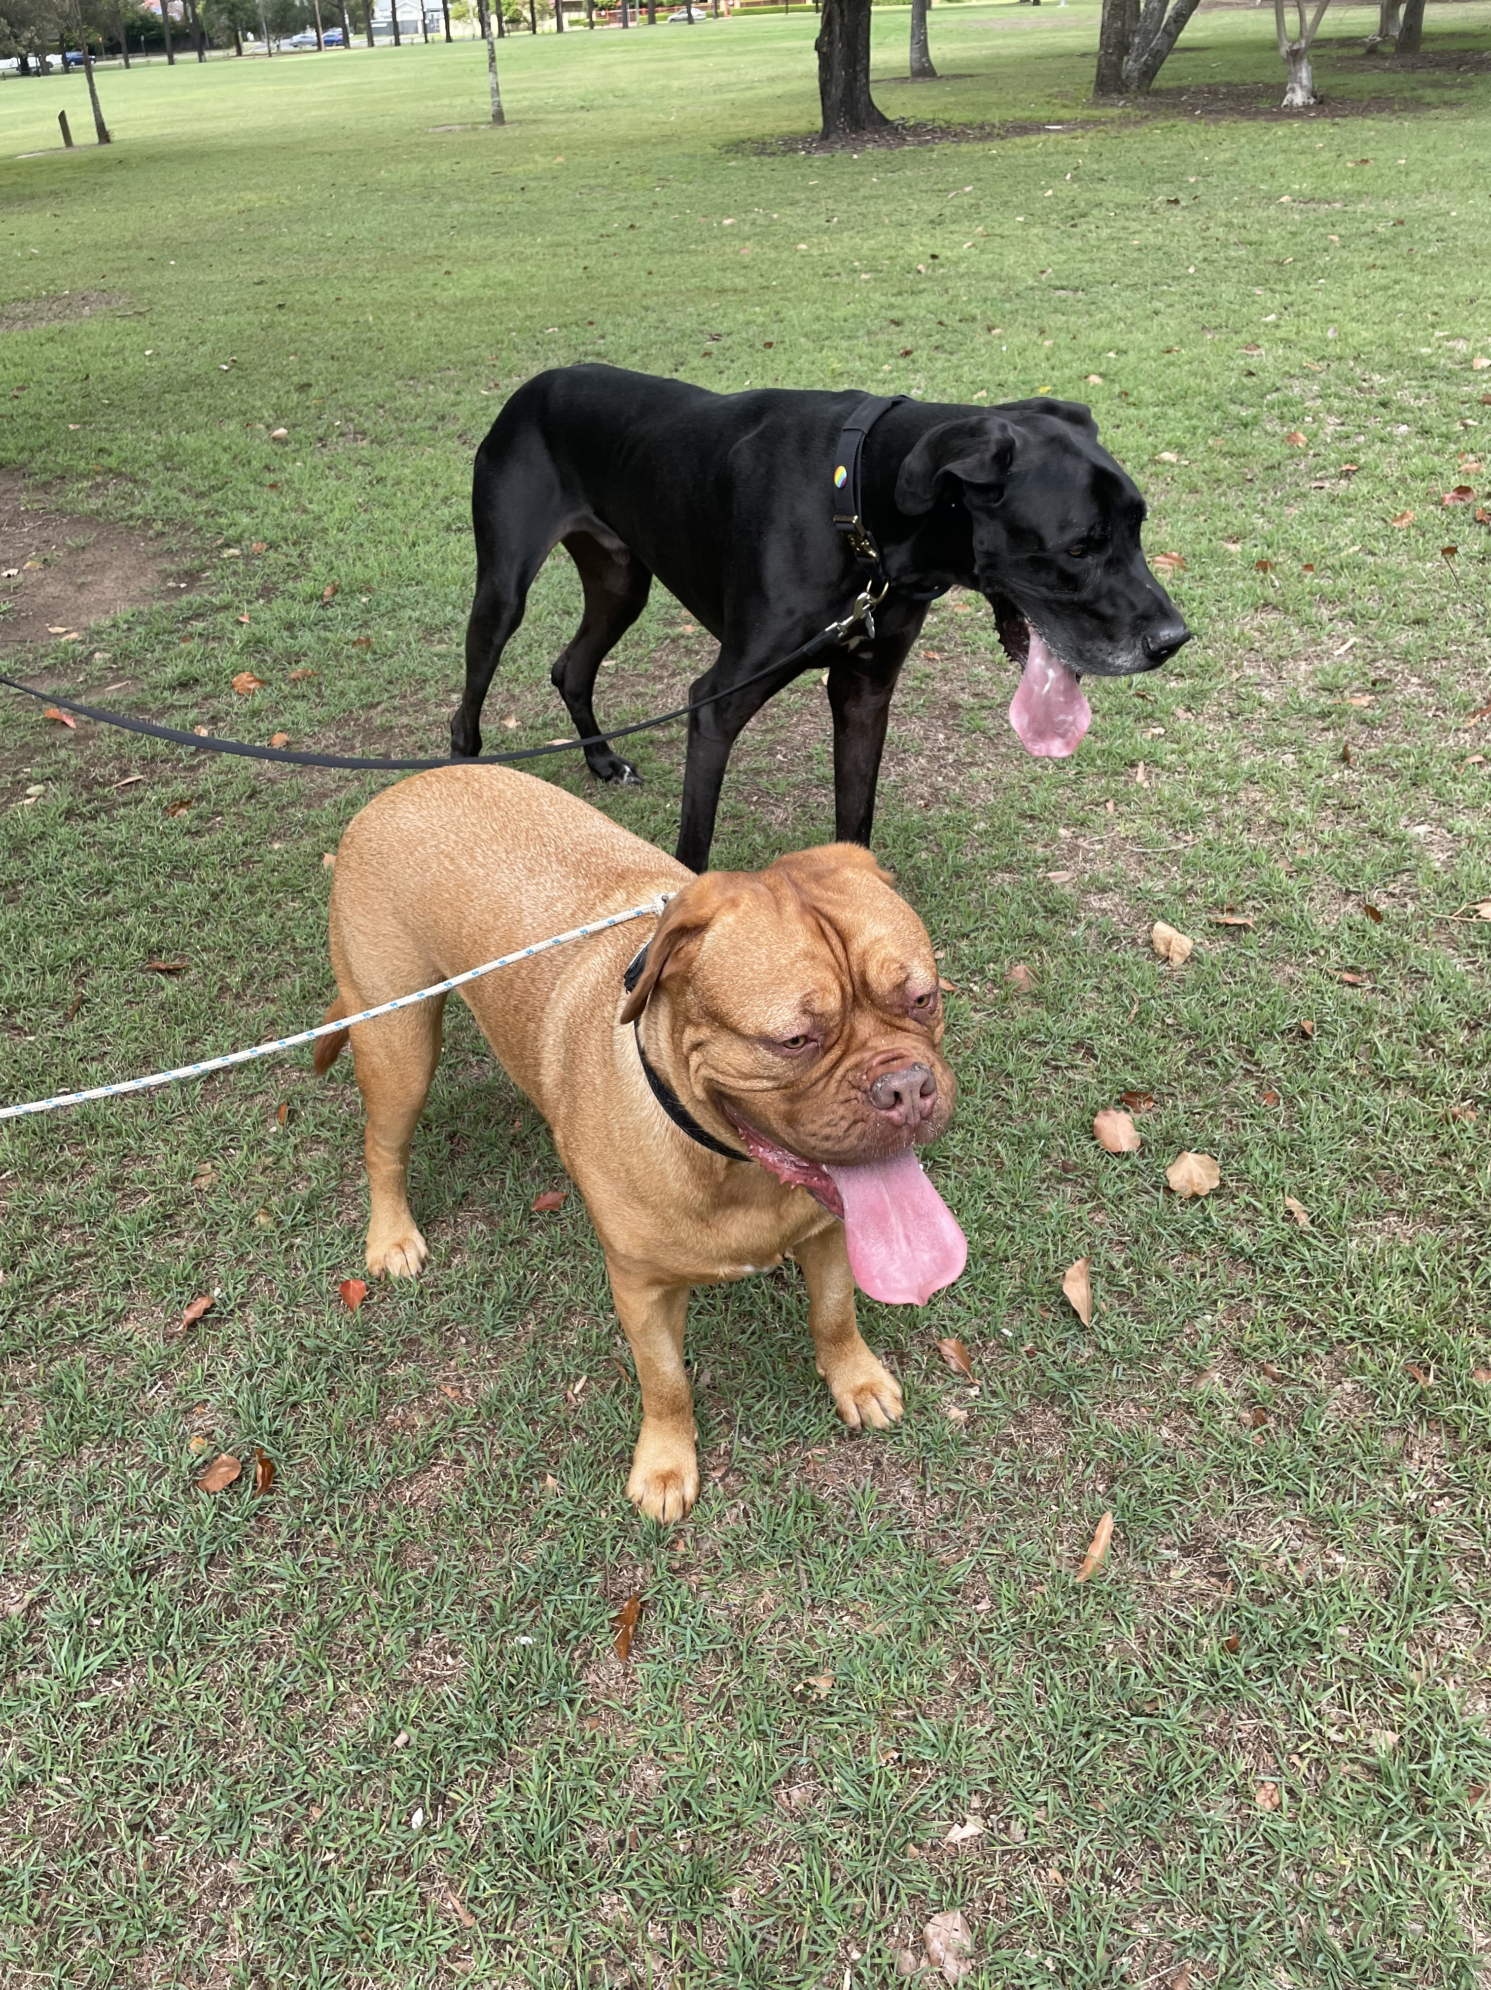
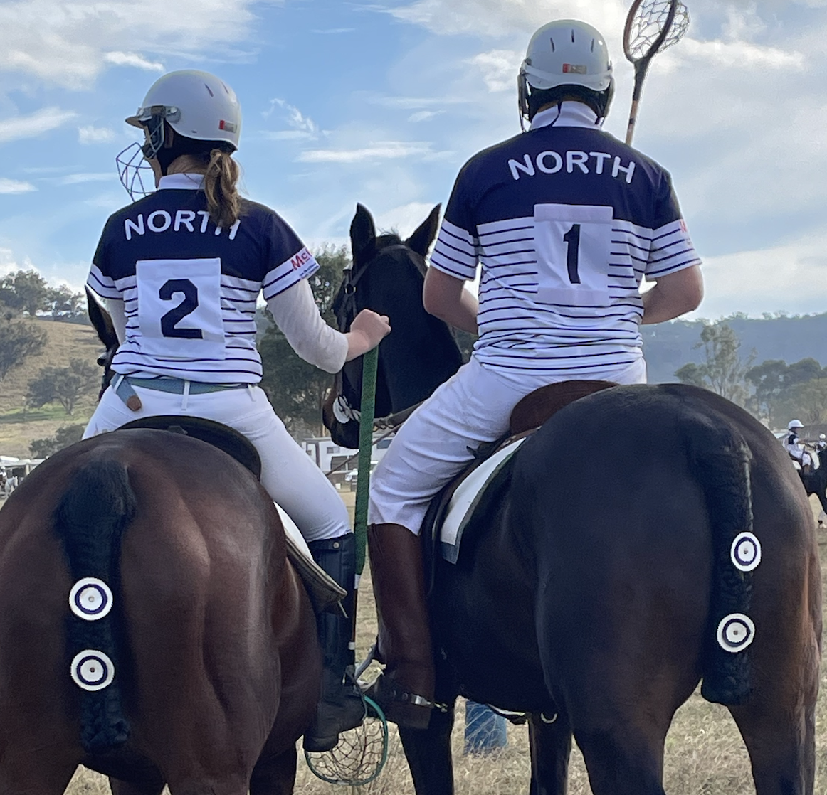
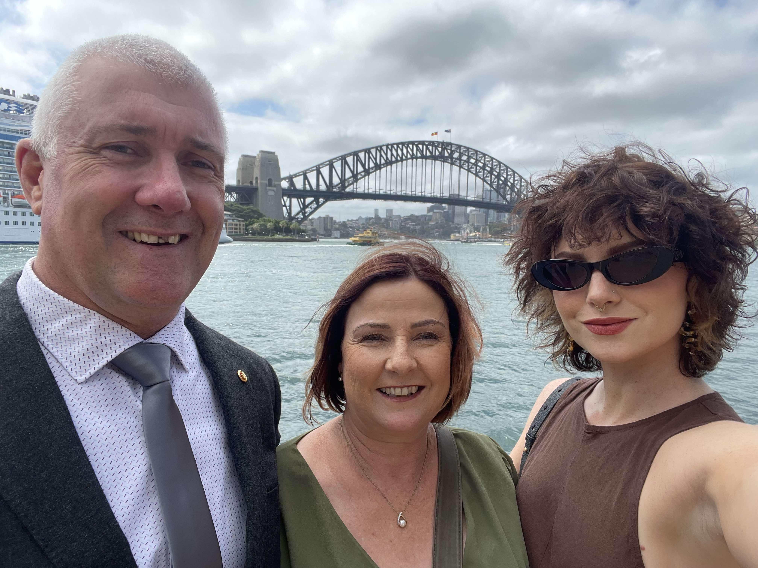
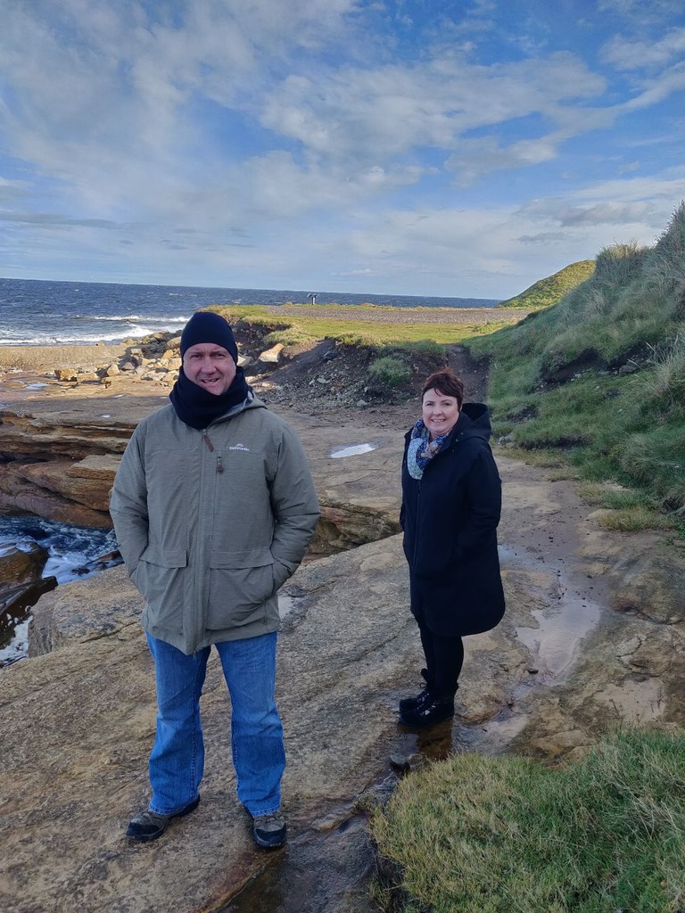
Hobbies and Interests
When I’m not at school, I spend time with my friends and family. Spending time with friends is very important to me. I love going to restaurants for lunch or dinner and shopping. I enjoy going to Polo Crosse to watch Matt and Emma play. I like watching Australia play cricket. Travelling is something both my husband and I love and wish we could do more of. It is great fun walking Bear at the park.

Slide 5
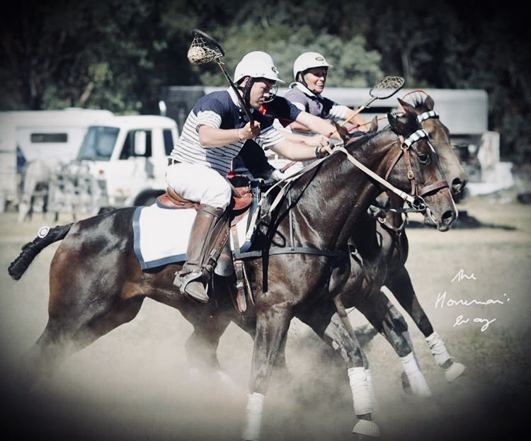
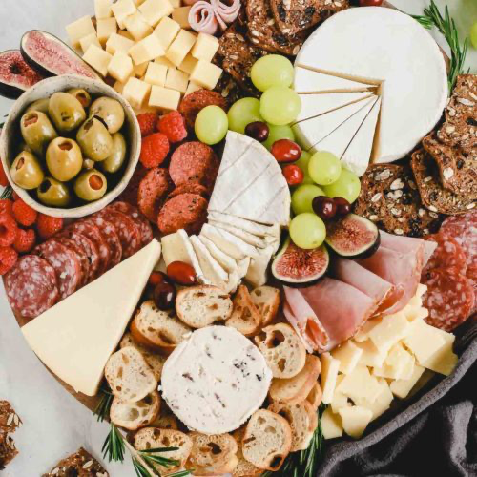
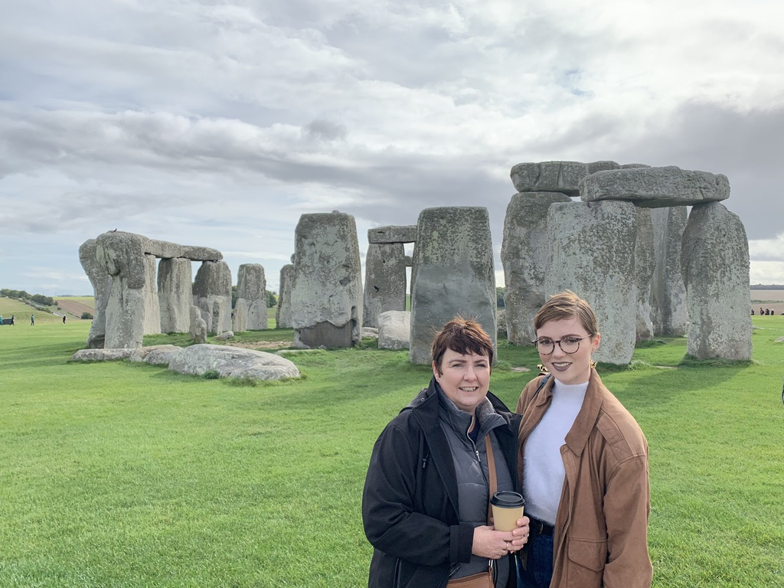
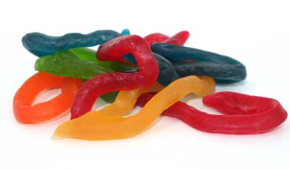
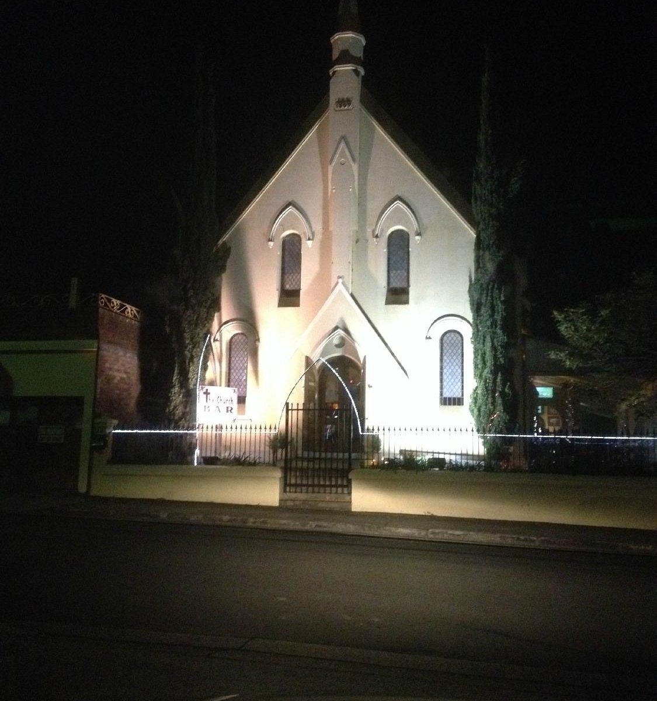
My Favourite Things
Food –Antipasto plate
Colour -Purple
Animal – Horses
Sweet treat- Snakes – not real ones
Country to visit - England and Scotland
Movie - Forrest Gump
Restaurant – The Church Bar
Shopping - Ikea

Slide 6
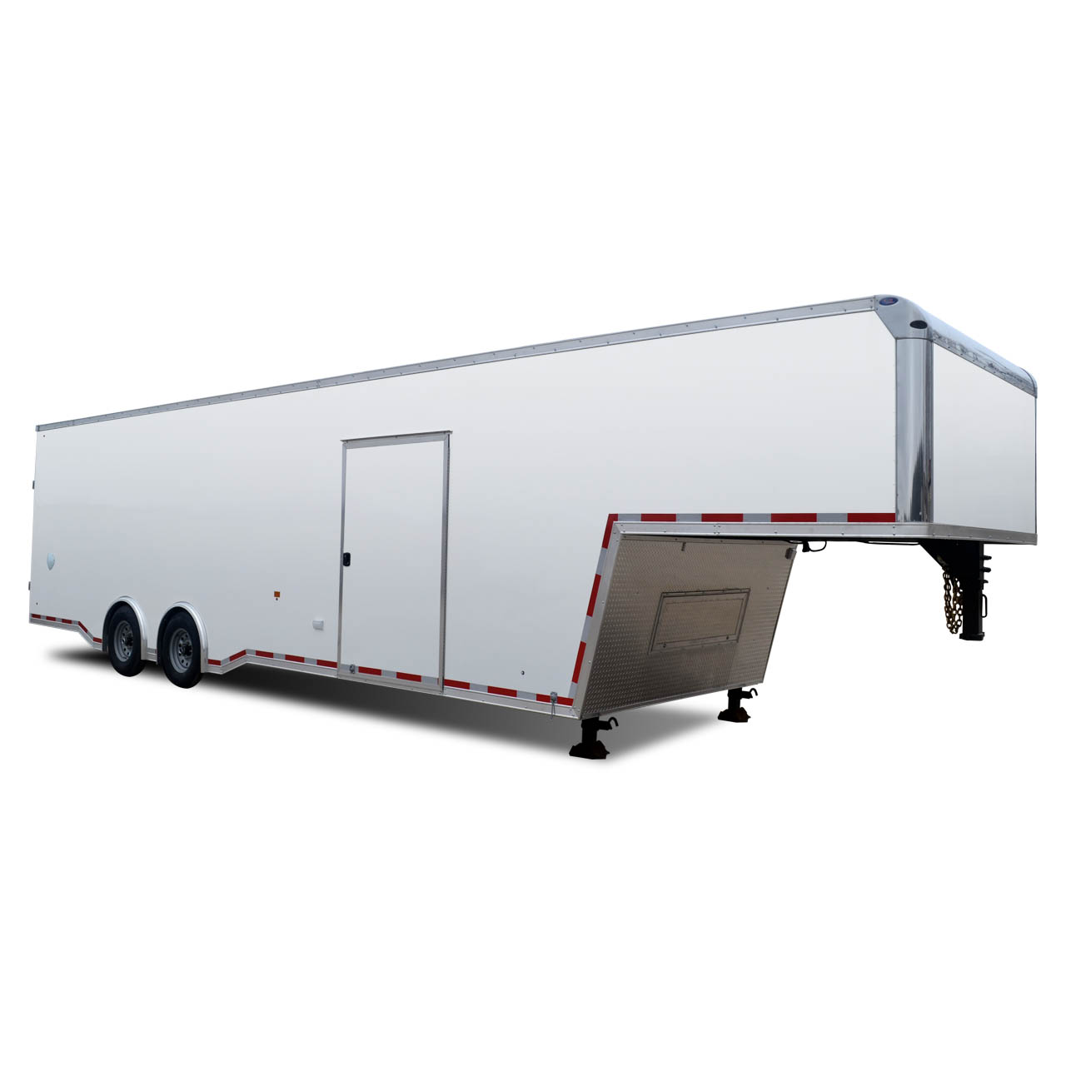
Fun facts about me!
I love horse riding and bush walking
I can not ride a motorbike or water ski
I am terrified of flying in planes and of snakes – the real ones
I do enjoy a sleep in on the holidays, and I love to read a good book with a coffee
I like gardening, especially growing my own vegetables and flowers
I love dressing up for special days at school
I can drive a truck and tow a gooseneck trailer
I can’t speak any other languages or play a musical instrument well

Slide 7
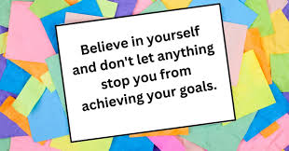
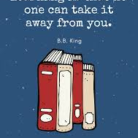
2025 is going to be an absolute fabulous year!
I love being an Assistant Principal and teacher at Windsor South Public School. I cannot wait to be back at school with my new class ready for a year of fun , learning and adventure. I am so excited to get to know my new students, their families, and to share my passion for learning with them.

