Slide 1
Our school librarian and
primary
support
teacher!
Meet Mrs Towner

Slide 2
About Me
I grew up in Lismore on the far north coast. It was very hot in summer but I loved cooling off with my friends at our nearby beaches of Ballina, Byron Bay and Lennox Head. I now live in the beautiful Blue Mountains. I have been teaching for a LONG time – 2025 will be my 27th year at WSPS! I have taught quite a few of the parents at out school! Out of the 4 schools I have taught at, I love being part of the Southie team the best.

Slide 3
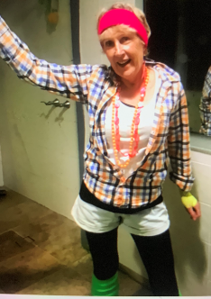
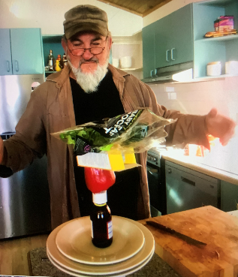
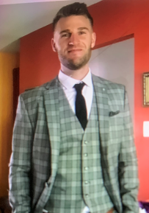
My Family
My husband and I live in the Blue Mountains. He is a builder, loves to garden and is very creative.
We both
like to
clown
around!
Our son, Brendan, lives in Dee Why
and is our only child.
He is a painter and loves to travel.

Slide 4
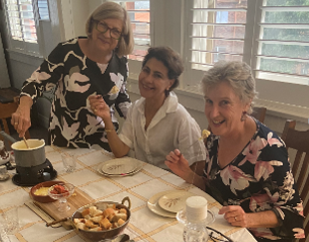
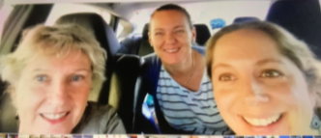
My Friends
I love to spend time with my friends chatting, having lunch or just going for a walk.
I’ve had lots of laughs with Mrs Saliba, Mrs McCloud and now Mrs McCarthy, driving to and from school.

Slide 5
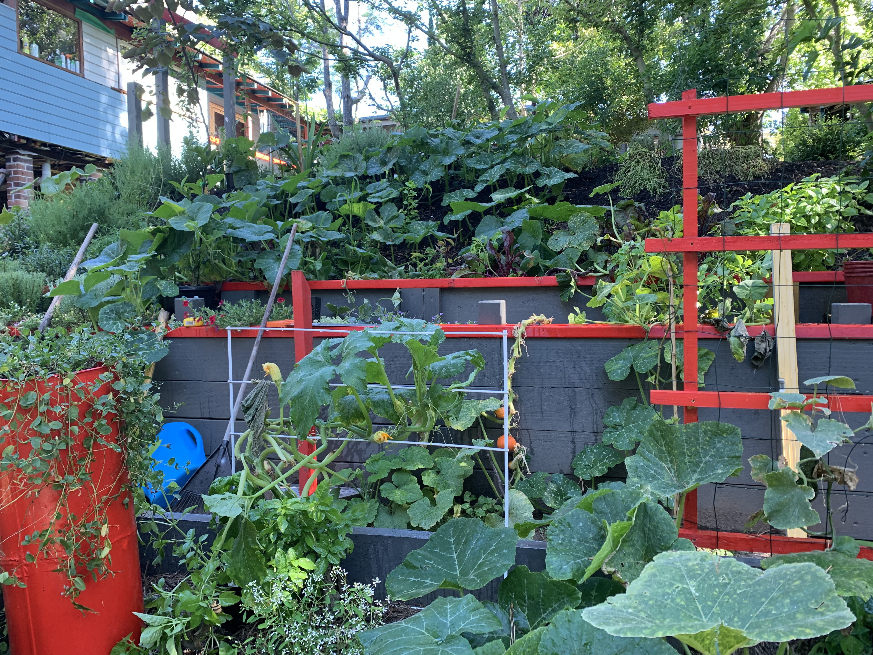
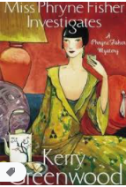
Hobbies & Interests
I love reading, and my favourite genre is mystery novels. Mr Towner and myself both enjoy gardening and spend hours in the garden. He does all the hard work and I do the weeding!

Slide 6
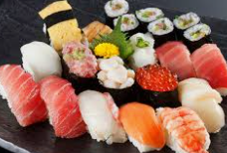
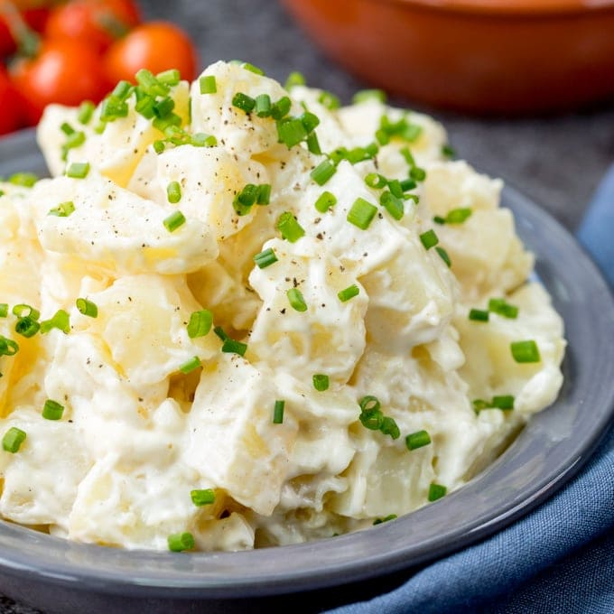
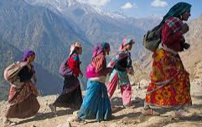
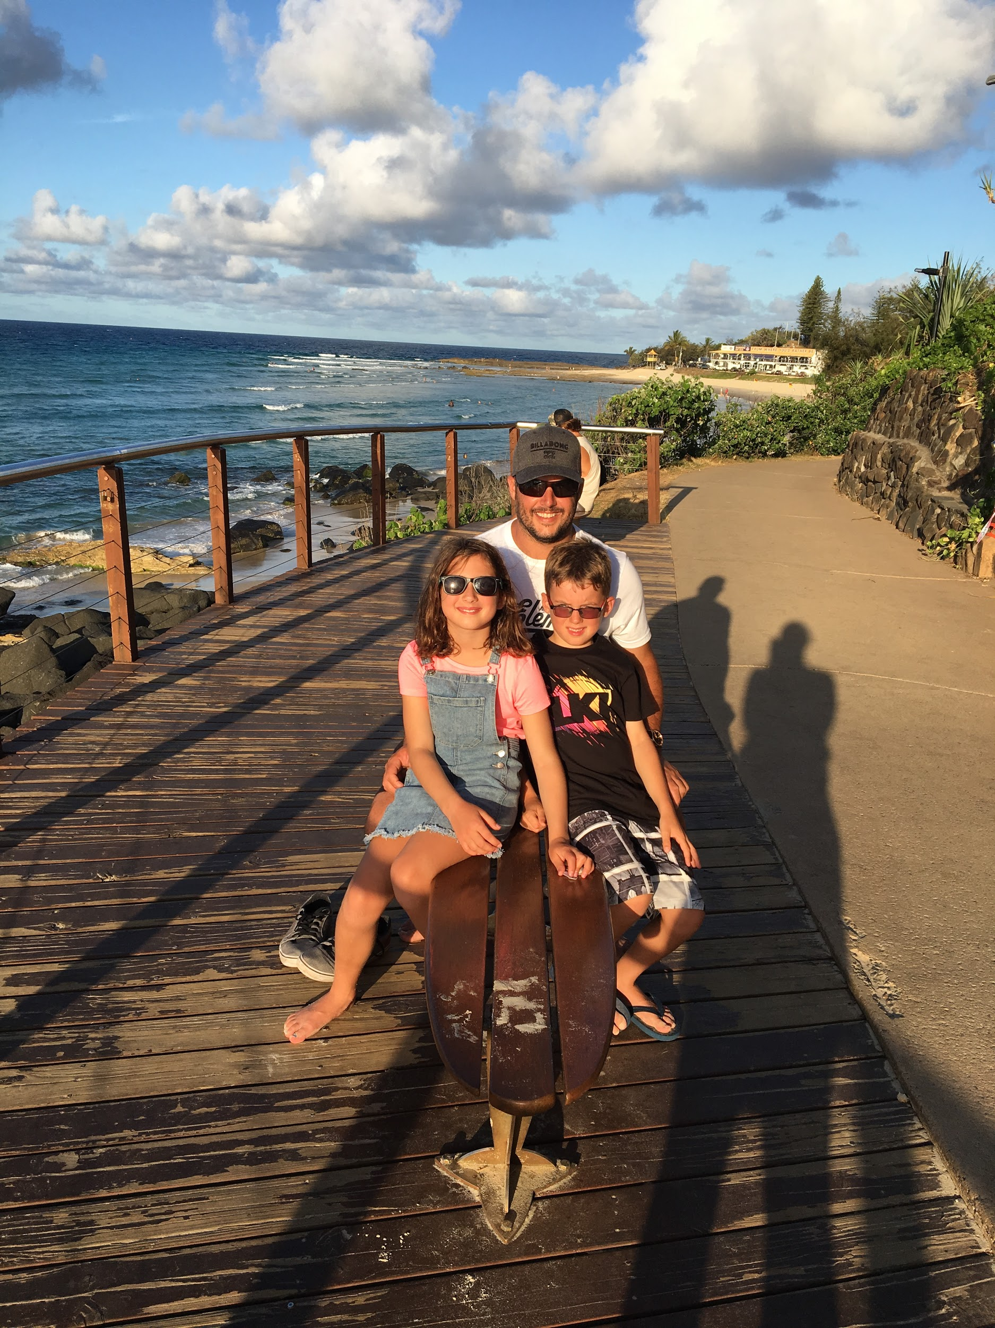
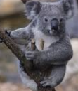
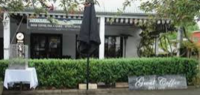
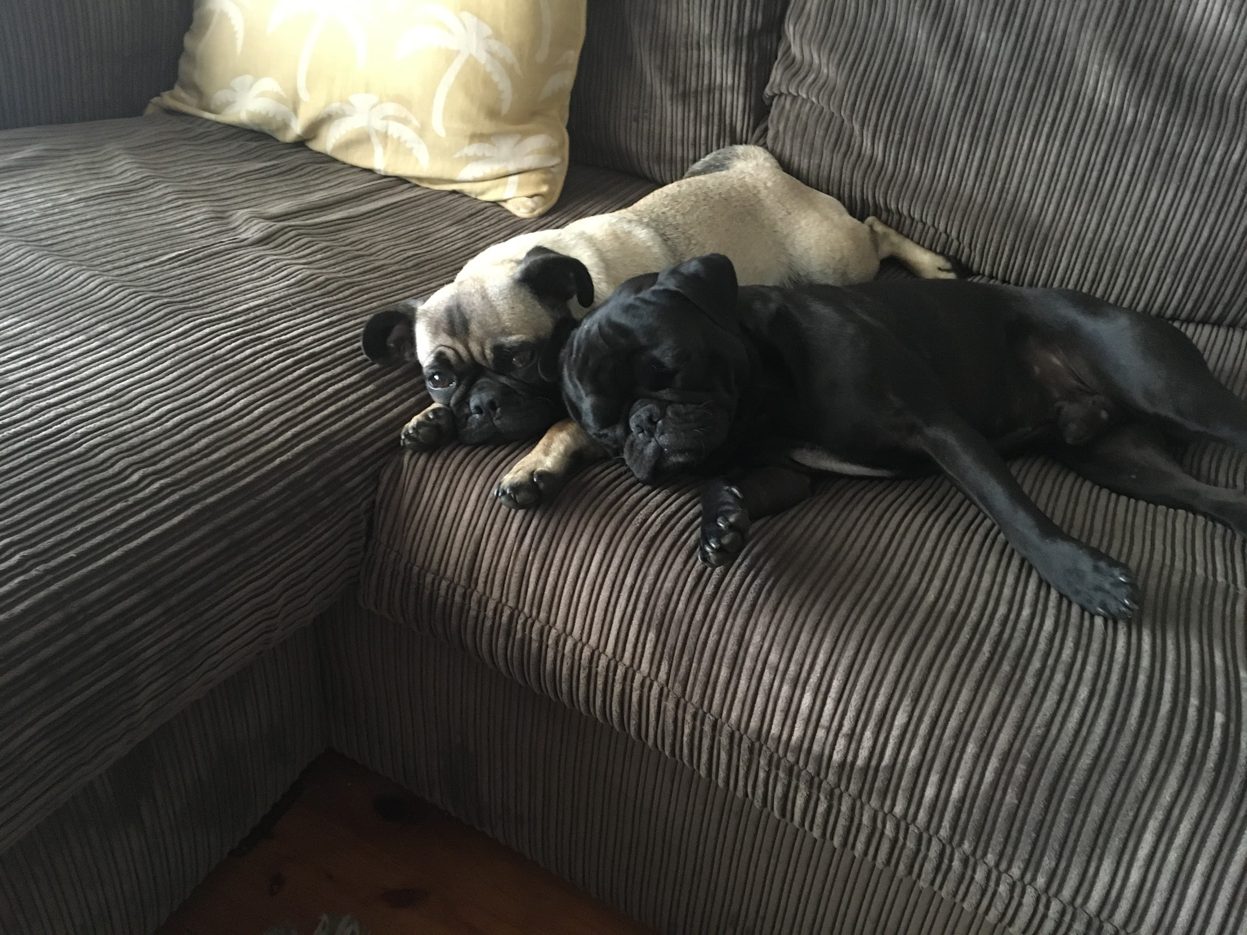
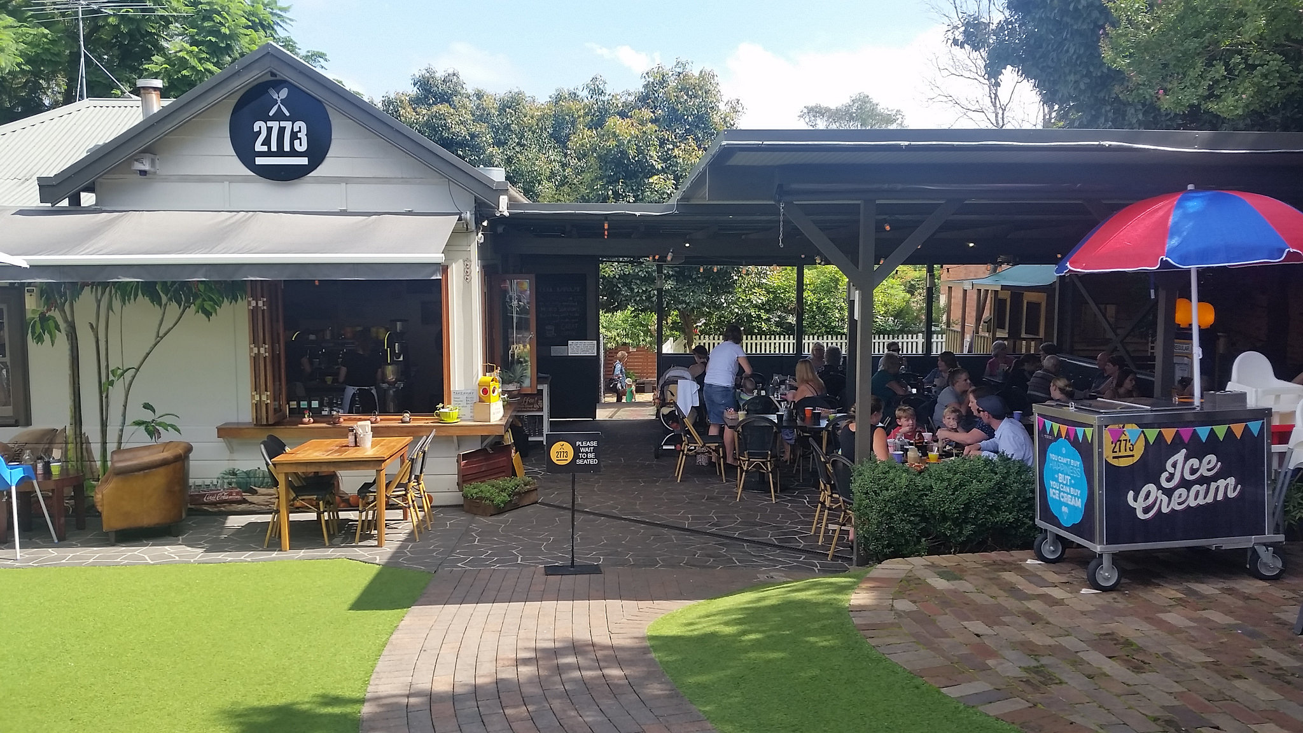
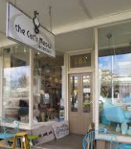
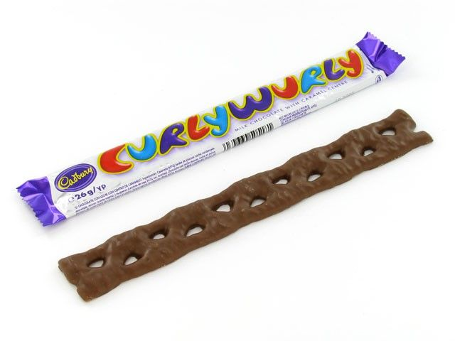
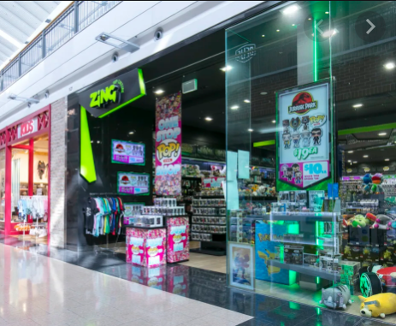
My Favourites
Sushi
Nepal
Aqua
The King’s Speech
Koala
Magpie Cafe
Crunchy Bar
The Cat’s Miaow

Slide 7
Fun Facts About Me
I used to work in an Easter egg factory! We made candy and chocolates eggs. YUM!
I love tomato soup and tomato sauce, but I hate tomatoes!
I am an April Fool!
I lose my glasses 10 times a day!
I had a rosella parrot that my dad taught to whistle Jingle Bells! His name was Joey.
I am an only child, and my husband has 6 brothers and 6 sisters!

Slide 8
See you all soon!
Can’t wait to see all your smiling Southie faces again!
2025 will be a fantastic year!

